Slide 1

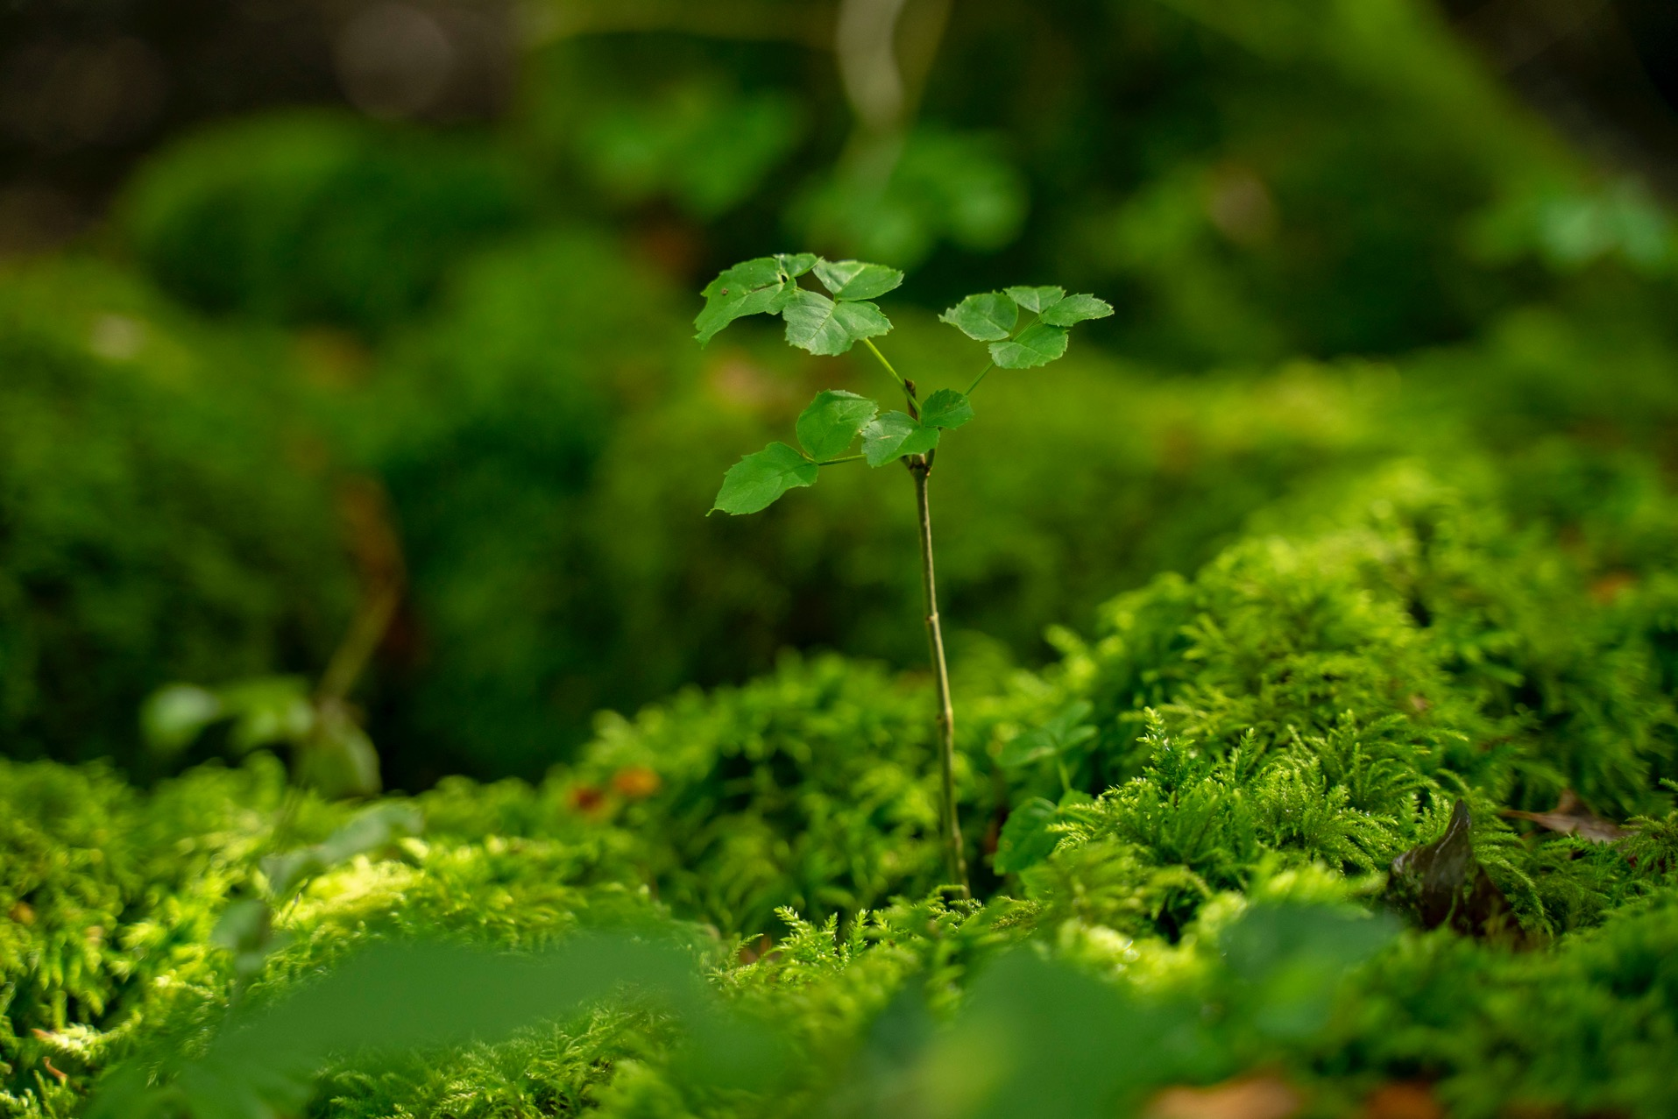

The forest
cycle
Notes:
This presentation takes you through the forest cycle, from seed, to tree, to sustainable wood products found in our homes and schools.

Slide 2
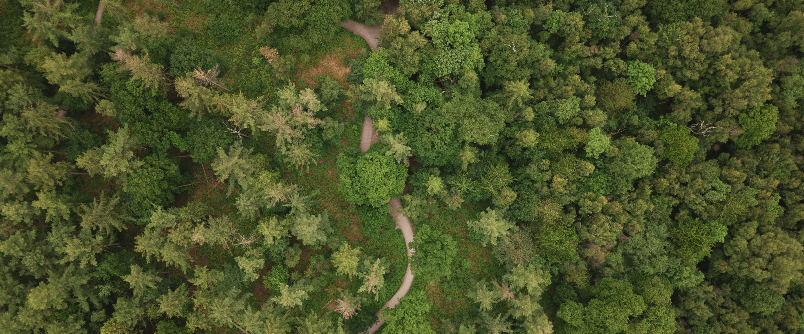

Bellever Forest, Dartmoor
Notes:
All forests and trees are different:
Some are old, some young.
Some are deciduous (trees that lose their leaves in the autumn) and some evergreen (trees that don’t lose all their leaves at once).
Some forests are made up mostly of conifers (trees that have cones, needle-like or scaly leaves, most of which are evergreen), and some forests consist of mainly broadleaf trees (with broad, flat leaves, mostly deciduous, for example oak, ash, beech) and some forests are a mixture of both.
All trees are important for different reasons and the healthiest, most productive and most resilient forests have a mixture of trees of different ages and species.
Q: Why are trees important?
A: - They give us oxygen and clean air.
- They provide homes and food for animals and help other plants.
- They lock up carbon and provide timber – a sustainable, renewable resource.
- They provide shade from the sun and shelter from the rain.
- They help to prevent floods by intercepting rainfall with their leaves and stabilising soil with their roots.
- They give us exciting places to explore and beautiful views to look at.

Slide 3

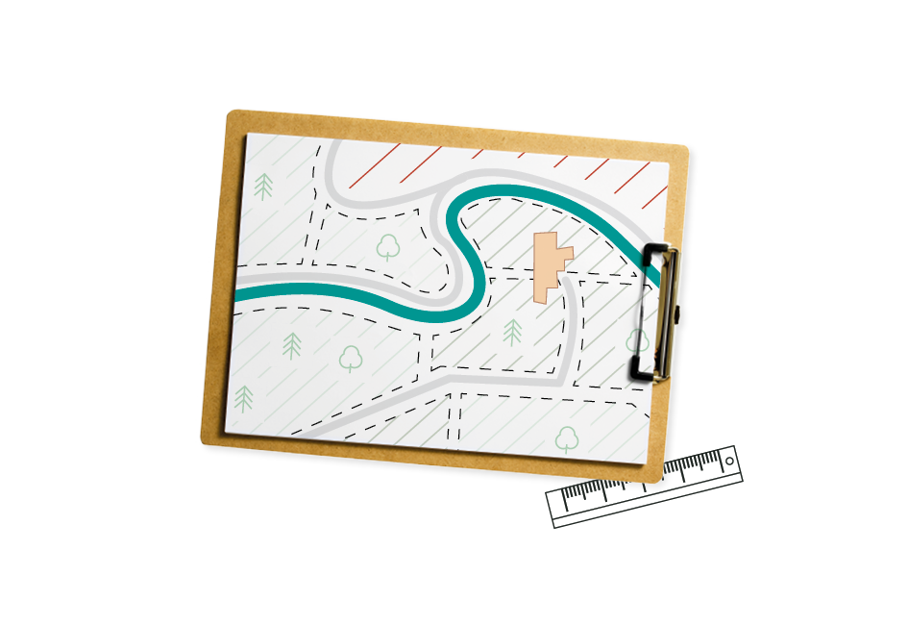

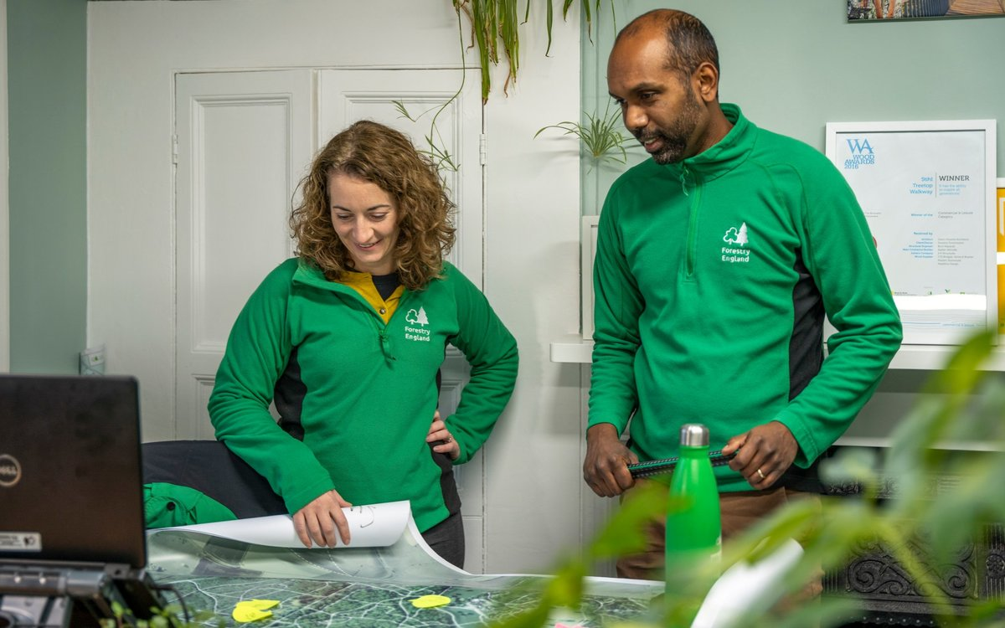
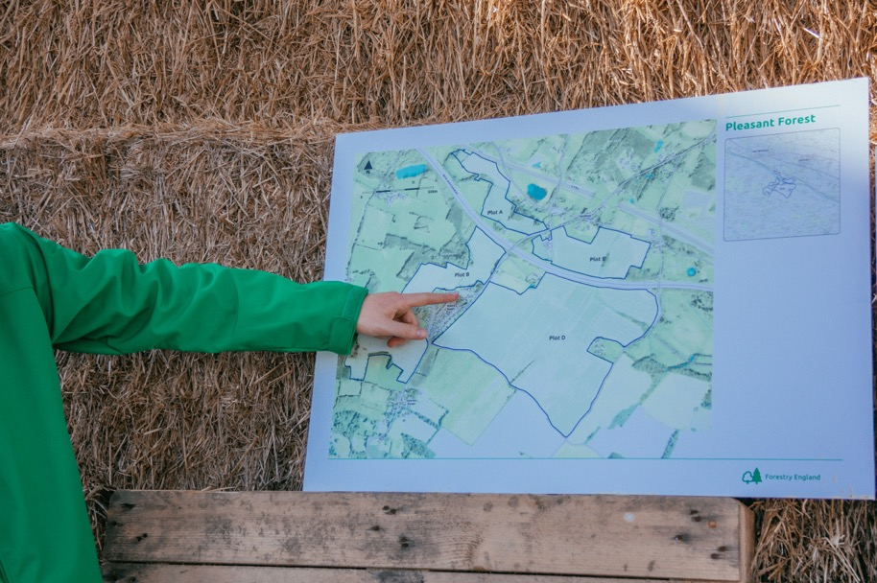
Planning
Symonds Yat, Herefordshire
Notes:
All Forestry England forests have a plan, so we know the best way to look after them
Forestry England cares for more than 1500 woods and forests (one-fifth of all the forests in the UK), and our task is to protect, improve and expand them, ensuring they are resilient for the future (which means they can cope with challenges including the changing climate and new pests and diseases).
All of Forestry England’s woods and forests have a plan which describes which trees should be planted where and when. The plans also tell us where the special habitats and protected areas are.
The plan makes sure the right tree is planted in the right place depending on the soil, landscape and local climate of the region. Different trees are better suited to different aims - some are good for timber, others have high value for nature.
Forestry England grow and plant a wide range of conifers and broadleaved trees; all carefully matched to site conditions and the aims of the forest. Last year Forestry England planted 92 different species of tree.

Slide 4
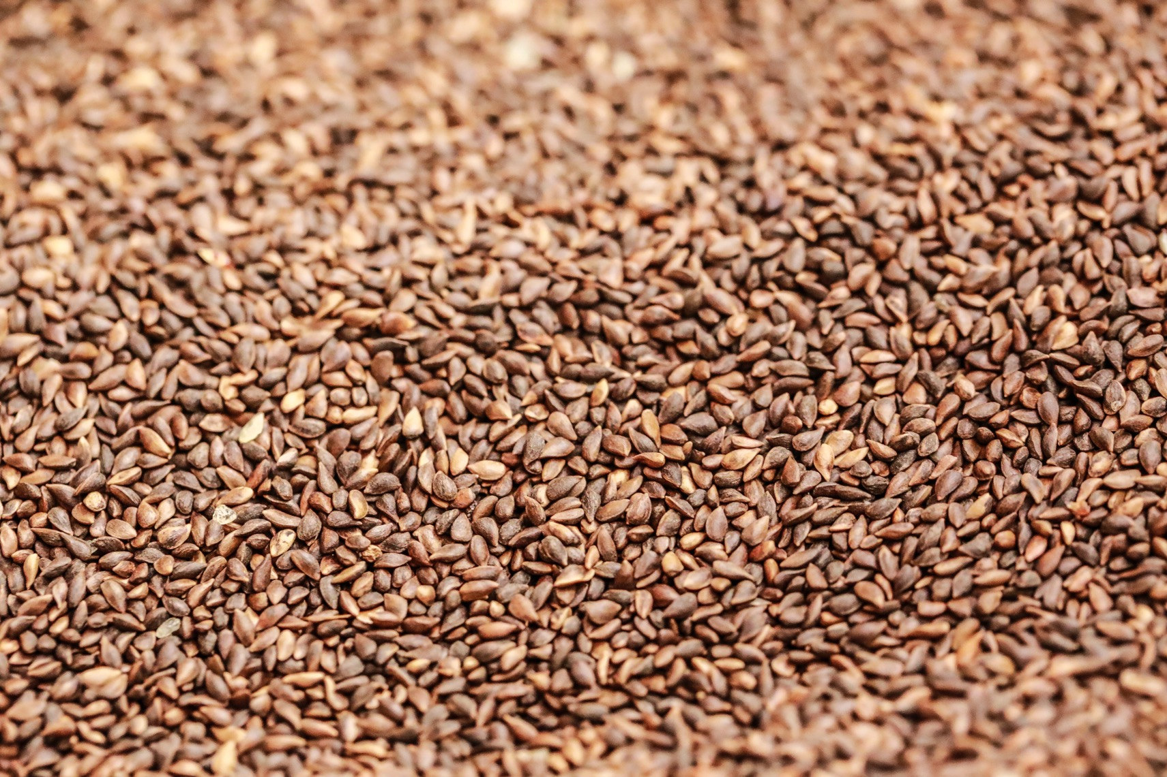
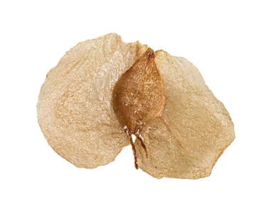
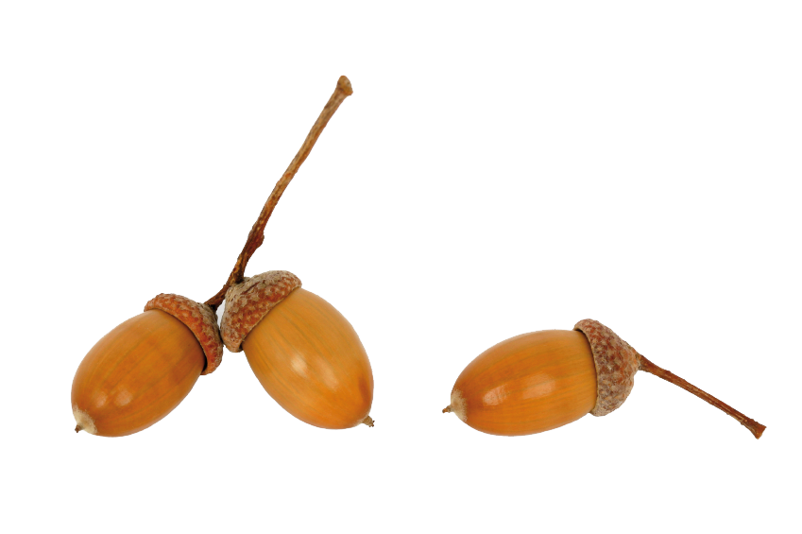
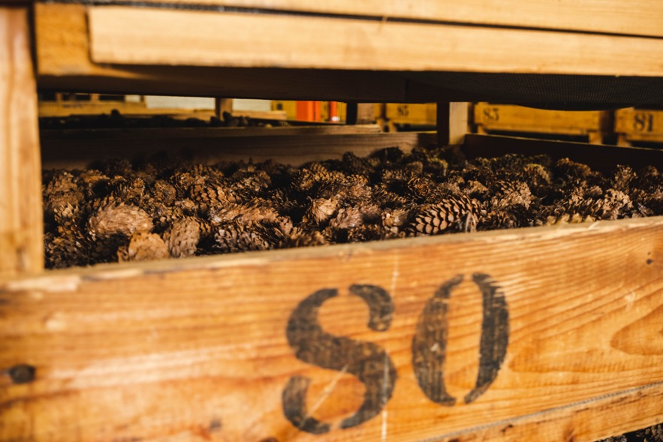
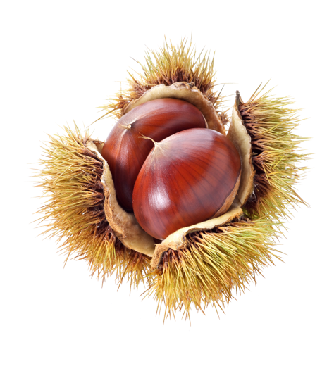
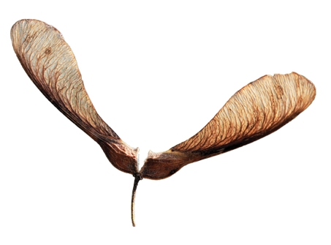
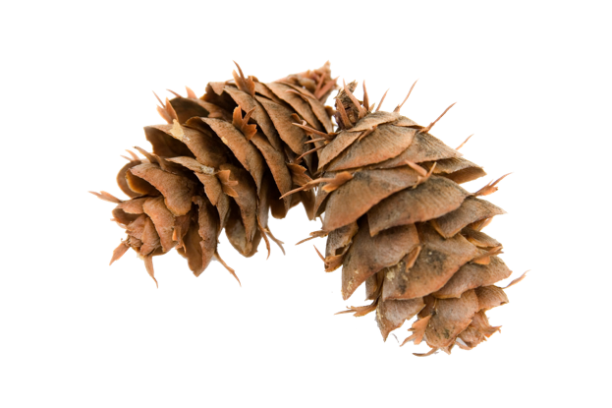
Seeds
Notes:
Trees grow from seeds, either naturally in the forest, or from seeds that have been collected
Trees produce seeds. Sometimes there are enough seeds in the ground from surrounding trees to develop the required woodland naturally. This is referred to as natural regeneration. Forestry England encourages natural regeneration wherever possible, but this can sometimes take time.
Forestry England collect the best seeds from the best quality trees to produce the strongest saplings that are adapted to their environment. Seeds are also sourced from places where the climate today is similar to site conditions we're expecting in the future, to give our forests the best chance.
Planting saplings that have grown from seeds ensures a new forest begins to grow more quickly and helps keep to the forest plan.
Q: Do you know which tree each of the seeds in the picture come from?
A: Left to right:
- The acorn is from an oak tree.
- The helicopter seeds come from a sycamore.
- The fir cone is from a Douglas fir (identifiable by its three pointy ‘mouse trails’ that stick out from between the scales).
- The nuts in the prickly case are from the sweet chestnut tree.
- The winged seed come from a silver birch.

Slide 5
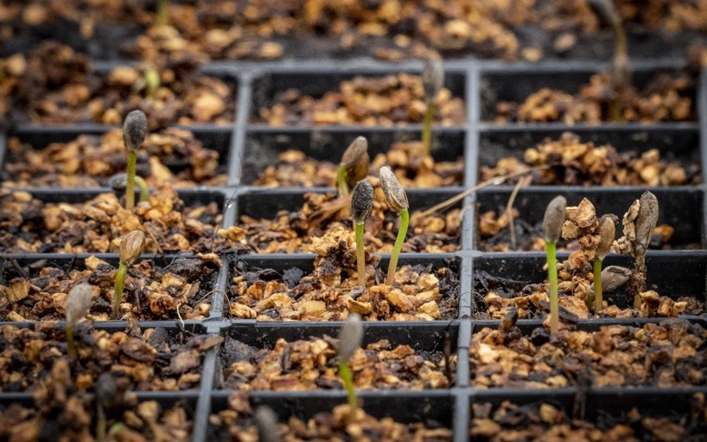
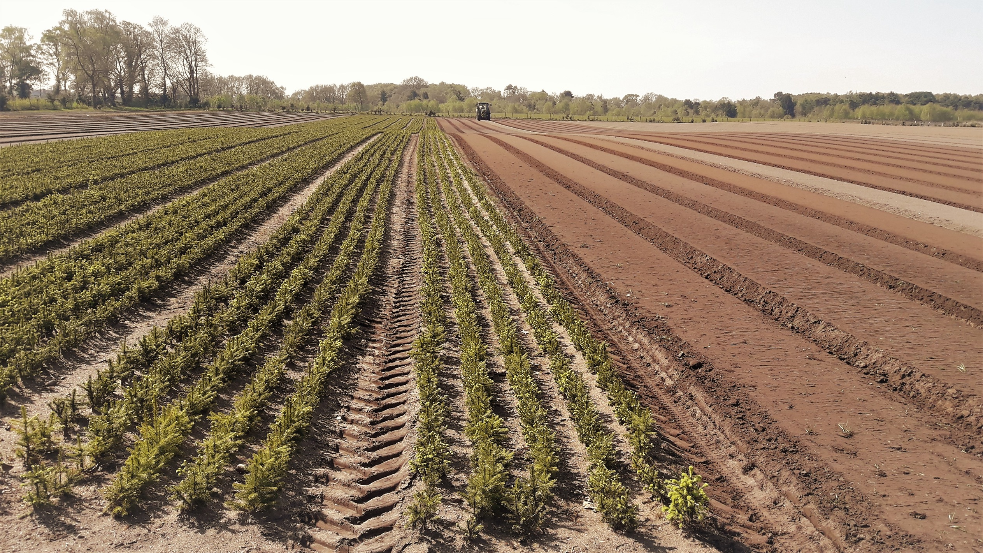
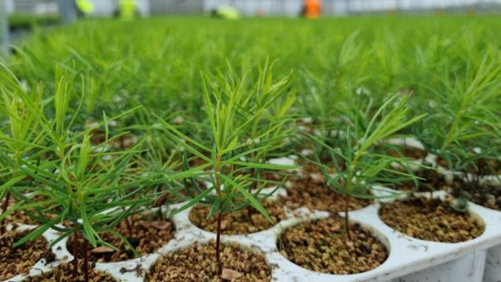
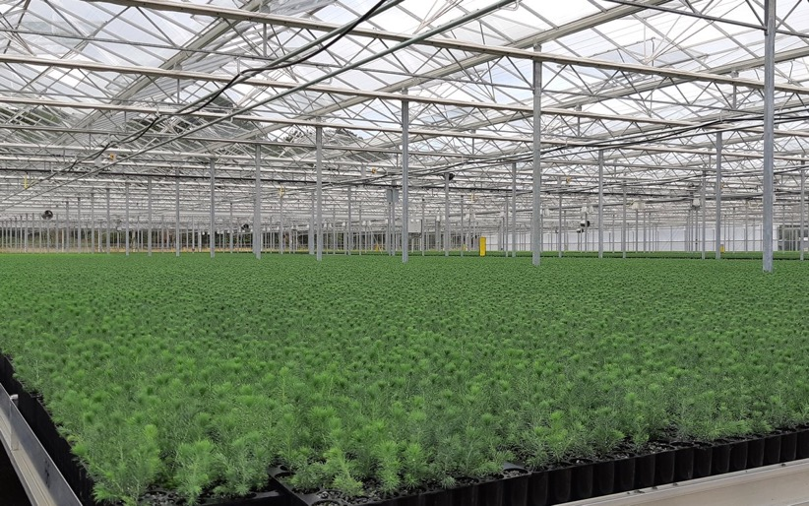
Forest nursery
Notes:
In the nursery, the seeds are planted and carefully looked after until they grow into small trees. They are then planted out in the nursery grounds to continue growing.
Forestry England grow 3.5 million trees from seed each year and another 3.5million in the open nursery, outside.
Q: What do the seeds need to germinate and grow?
A: Water, oxygen and the right temperature. Some need light, whereas other prefer the dark. Seeds will store their own food that they need initially, but they will soon need a supply of nutrients (normally from soil) and light to continue growing.

Slide 6
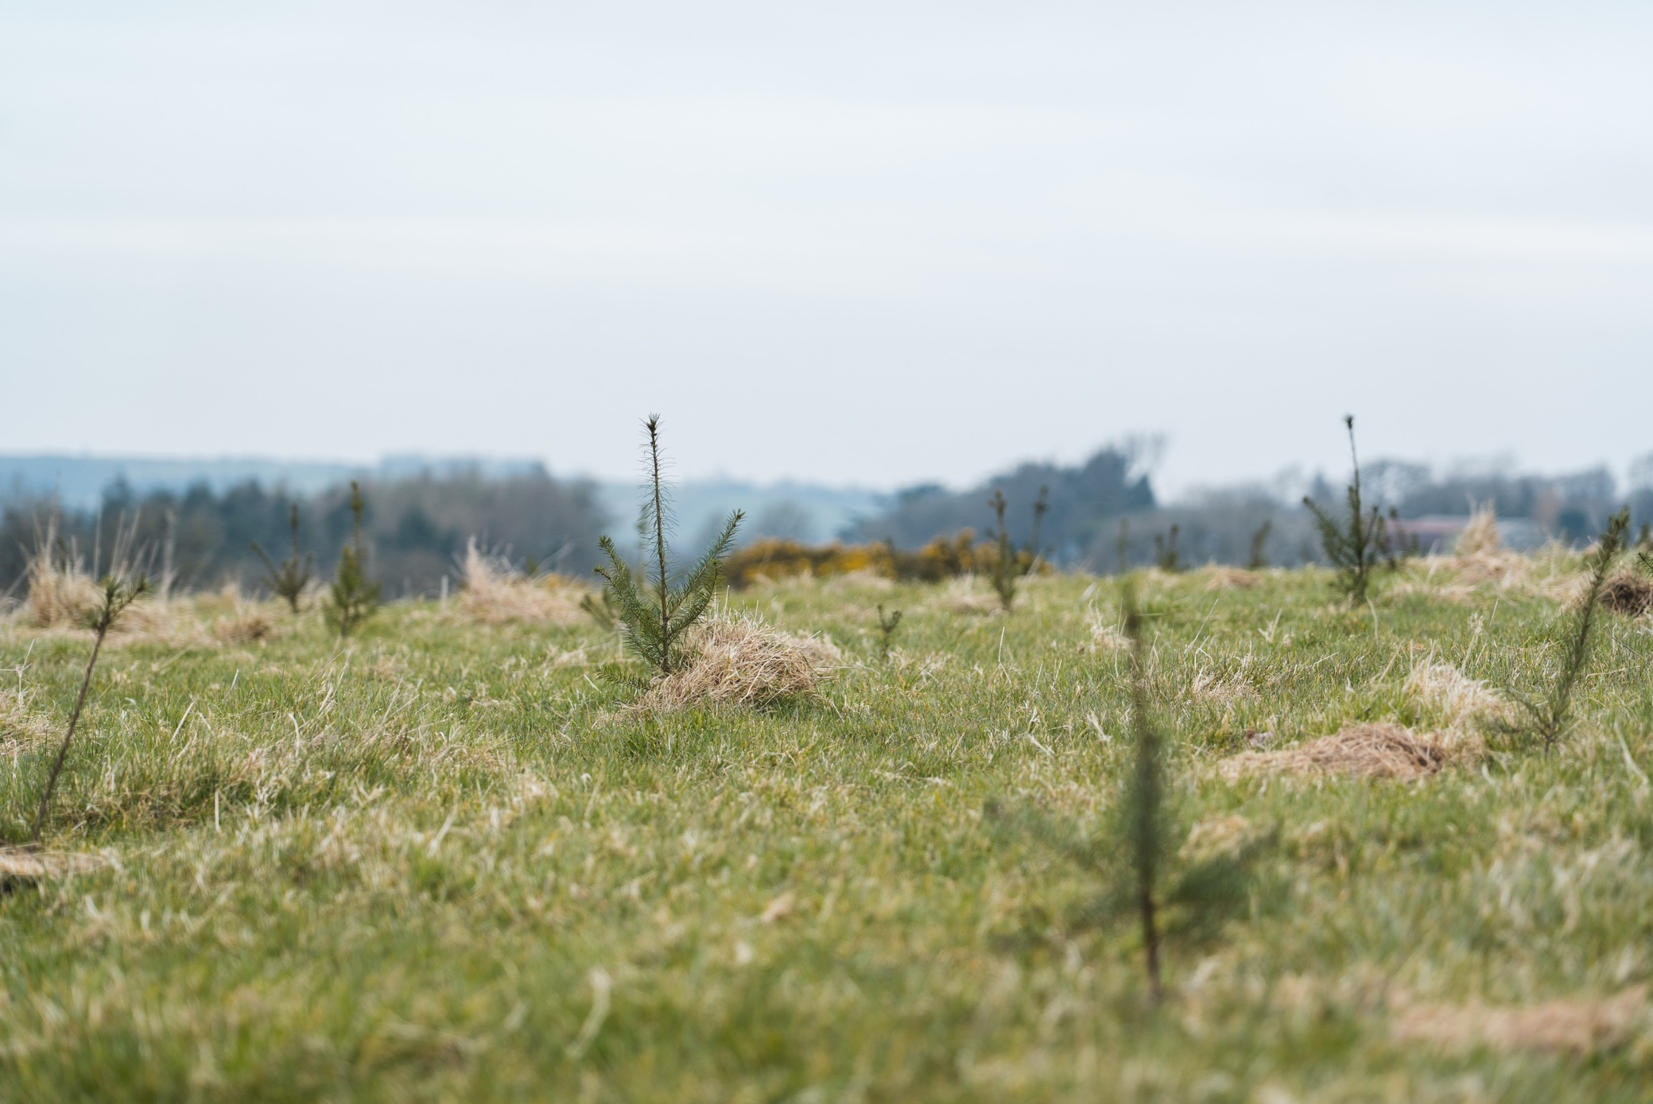
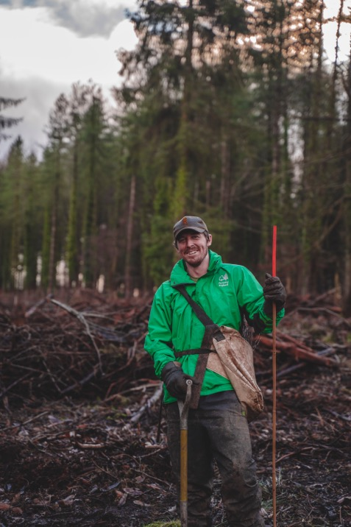
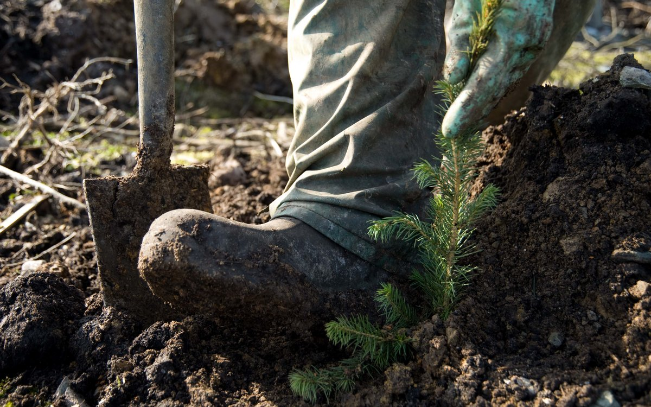
Planting trees
Notes:
When the young trees (saplings) have grown large enough they are dug up from the nursery bed and planted out, by hand, in the forest soil.
They might be planted where the trees have previously been cut down, or in spaces underneath older trees (which is called underplanting). Or they might be planted somewhere to create a brand-new forest.
Q: How old do you think saplings are when they are planted in the forest?
A: It varies, but most conifers are two years old when they are planted.

Slide 7
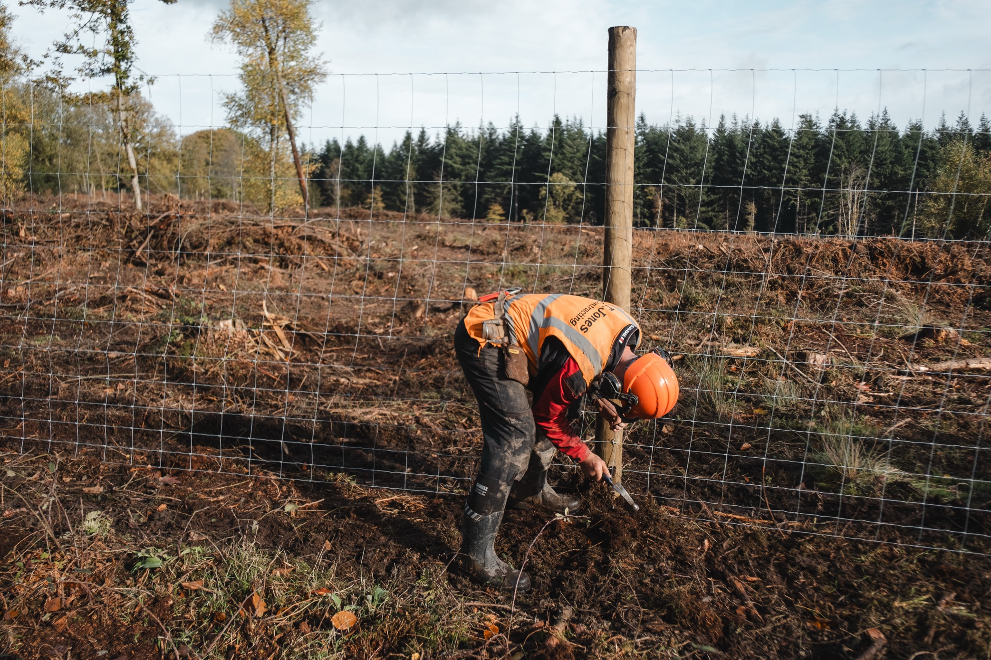
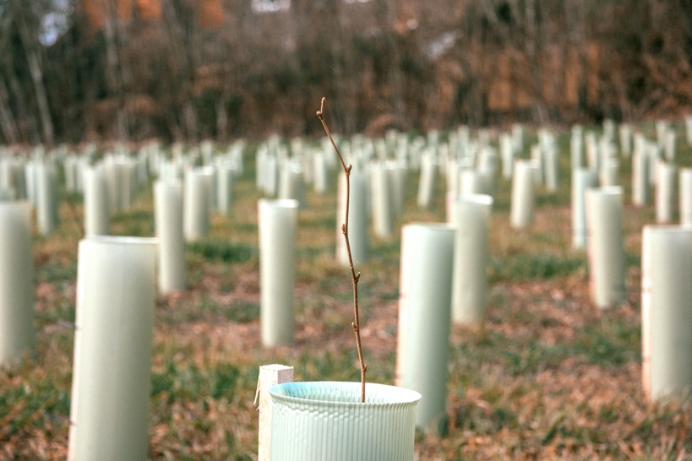
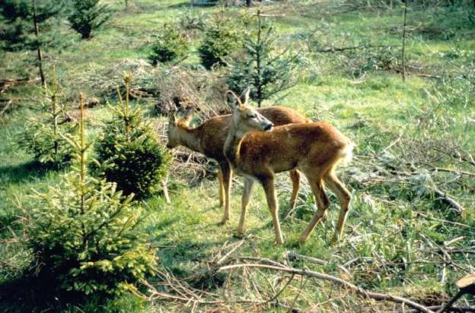
Protecting
young trees
Notes:
Some young trees need protection from animals that may want to nibble their leaves and stems.
The first five years of the tree is the most important and a forester will take extra care to ensure the tree has a good chance of surviving.
Q: What sort of animals do you think trees need to be protected from?
A: Fences are often put around newly planted areas to keep deer out, and individual trees may be protected from rabbits, squirrels and other rodents with tree guards.

Slide 8
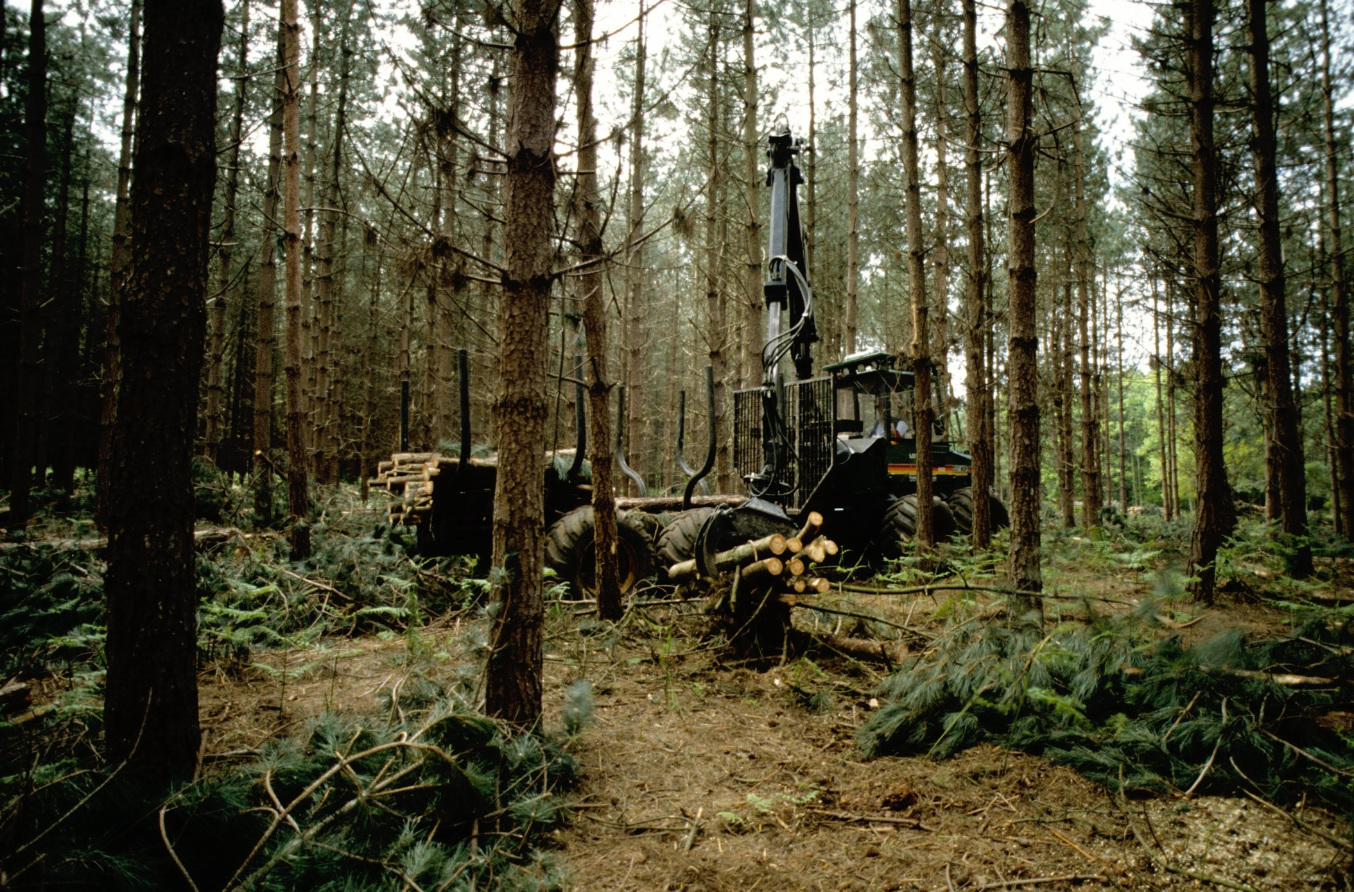
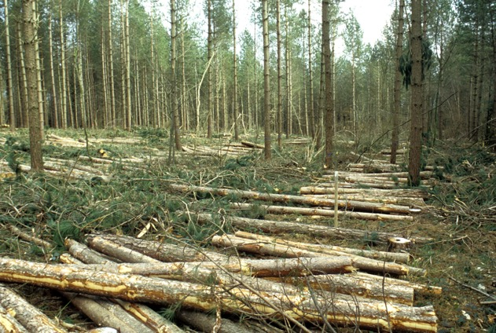
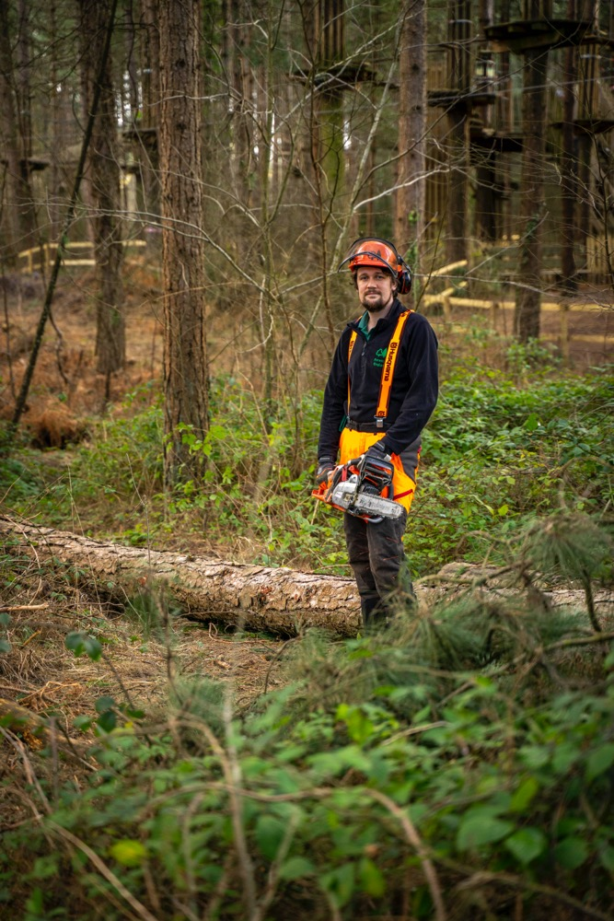
Thinning
Kielder Forest & Water Park, Northumberland
Notes:
Thinning is when some of the trees are removed to create more space
Trees are often planted close together so that they grow tall and straight with fewer branches. This produces stronger timber with fewer knots in the wood.
Some trees will not grow as well as others, so the smaller trees are cut down to create space and light for the others to grow better. This is called thinning.
The wood from the smaller trees that are thinned is used for things like fence posts, pallets, wood chips and fuel. The remaining trees will carry on growing and produce a good quality timber crop.
Thinning lets more light into the forest floor, which increases the diversity of plants in our woodlands and encourages more wildlife.

Slide 9
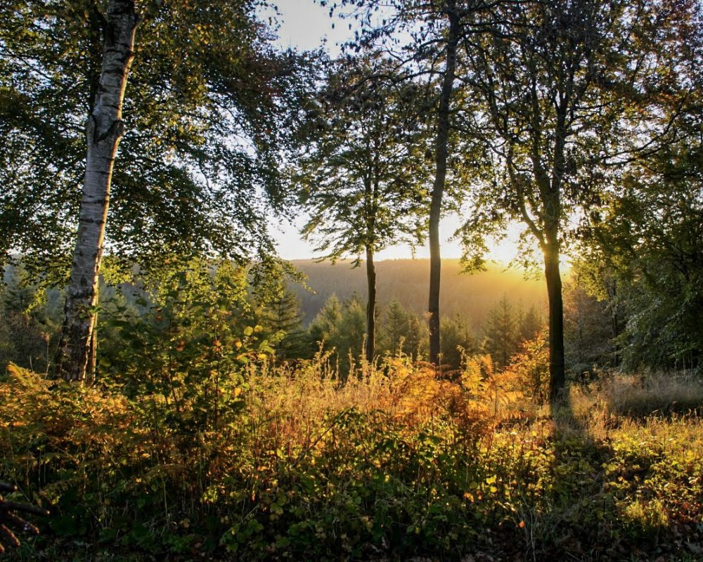
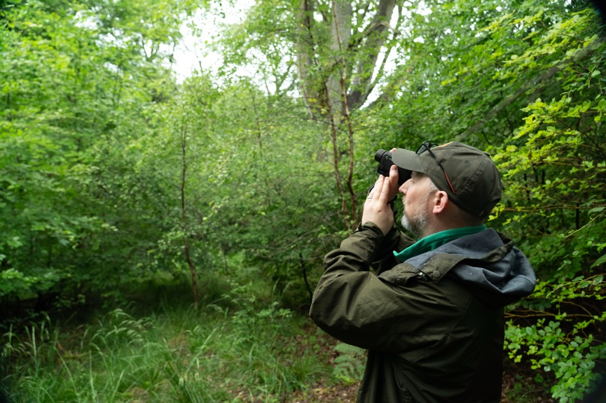
Sure, steady growth
Westonbirt, The National Arboretum, Gloucestershire
Notes:
As trees grow over the years, they are monitored for signs of disease or damage.
The changing climate means that new pests and diseases are finding a home in our forests, so it's important to make sure our trees are healthy to combat this threat.

Slide 10
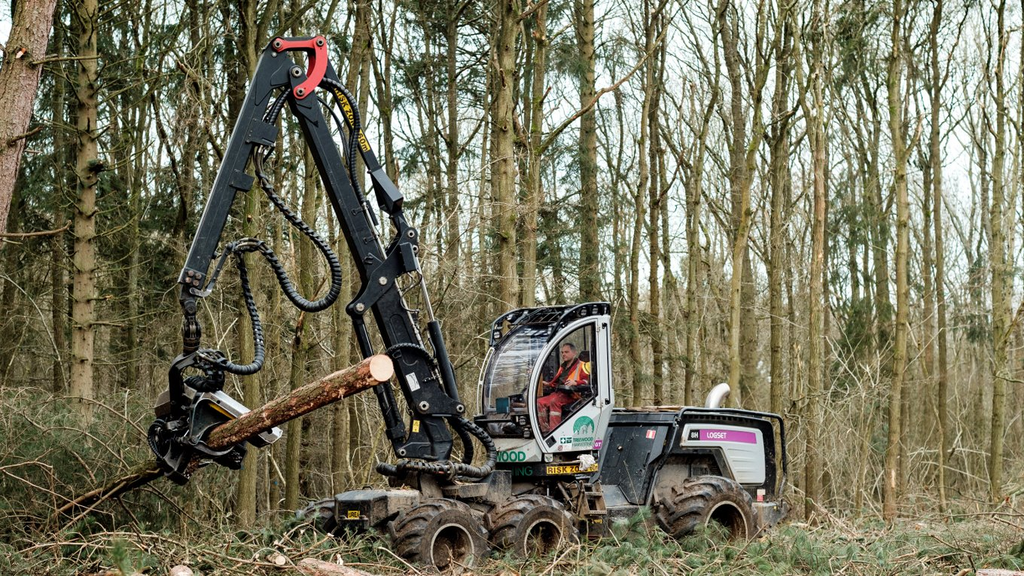
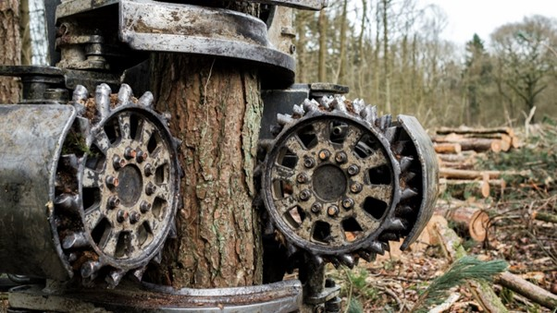
Felling
The New Forest, Hampshire
Notes:
This machine is called a harvester and is often used to cut down trees.
A harvester is a big, powerful machine that can cut down a tree, strip its branches, calculate the volume of timber, and cut the trunk into logs, all in less than one minute.
Once a tree is fully grown, it might be harvested for the valuable timber. This can happen anywhere between 40 and 150 years after planting, depending on the type of tree and what it says in the forest plan.
Sometimes a large area of woodland is harvested. Other times individual trees or small blocks of trees may be removed.
In sensitive areas, chainsaws might be used instead of big machinery, and horses can be used to take the timber away.
Harvesting trees creates space for new trees to be planted - resulting in forests with trees of different ages, or it might be left as open space to create homes for different wildlife and plants.
When trees are being felled and there are big machines working in the forest, it is really important to follow any instructions or warning signs.

Slide 11
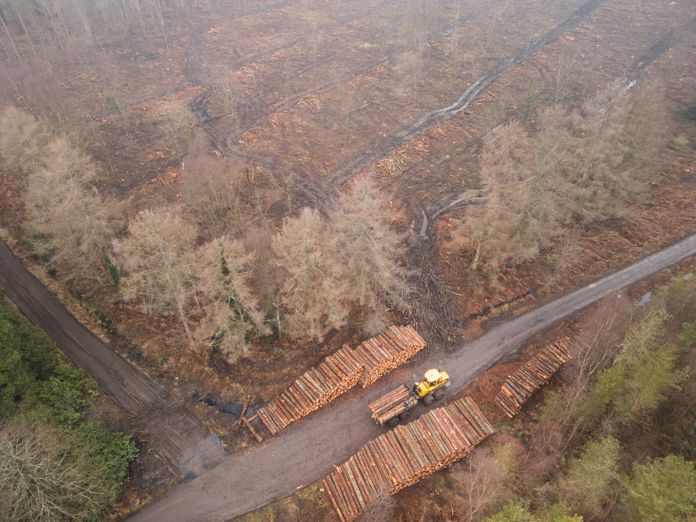
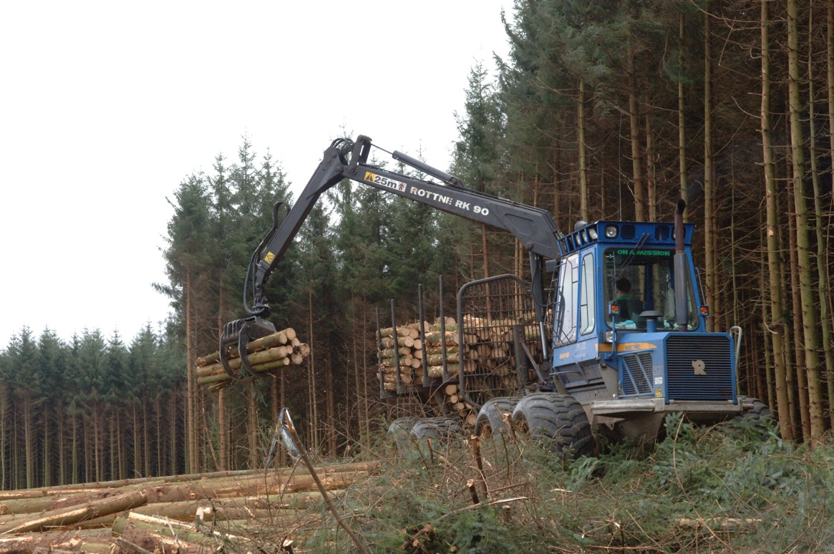
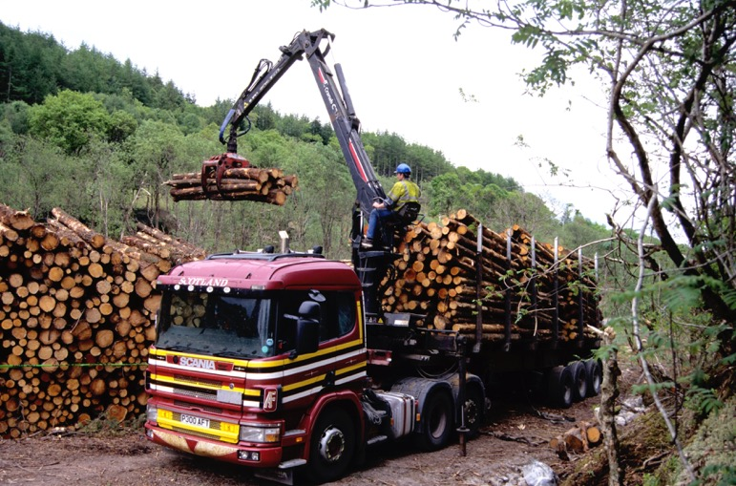
Timber
Notes:
The harvested logs are then picked up by another machine called a forwarder, which carries them to the edge of the forest track and stacks them in a big pile, so they are ready to get loaded onto the timber lorry.
It’s important not to climb on log stacks, as they could easily fall down.

Slide 12
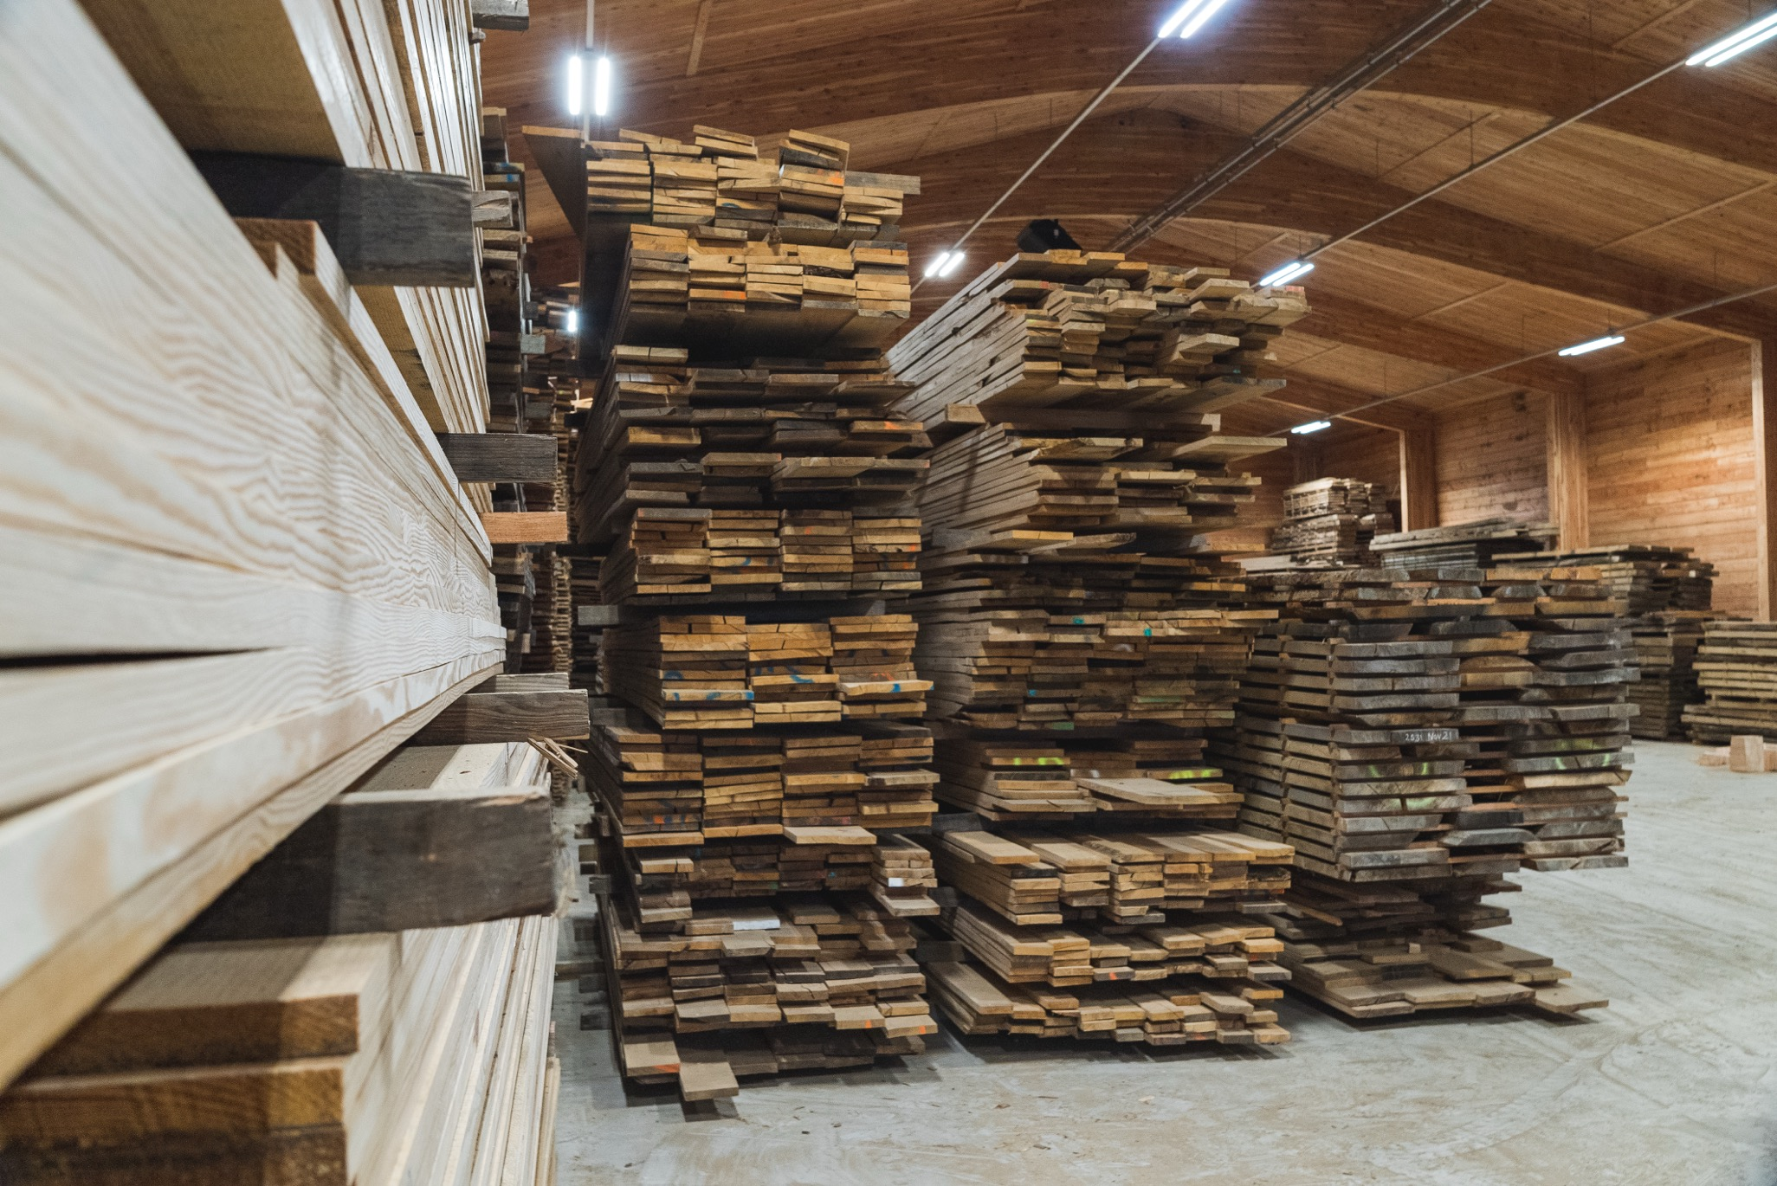
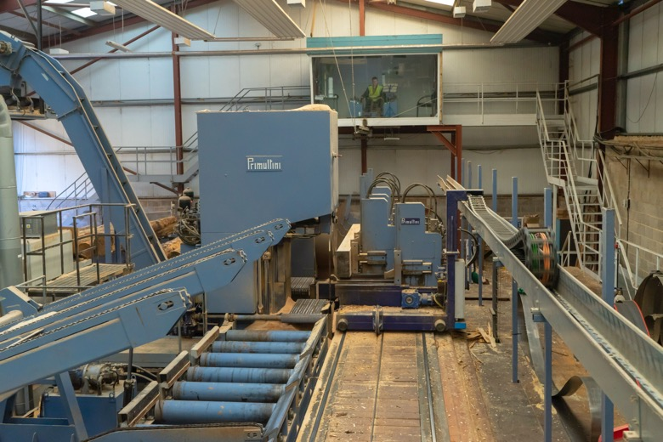
Sawmill
Symonds Yat, Herefordshire
Notes:
Many of the logs are taken to a sawmill.
At the sawmill, the timber is cut into different pieces and used in furniture, fences and building materials. Even the bark, wood shavings and sawdust are used. Nothing is wasted.

Slide 13

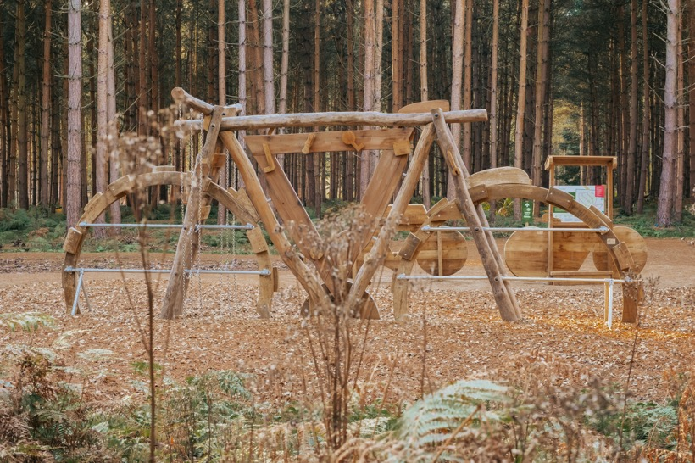
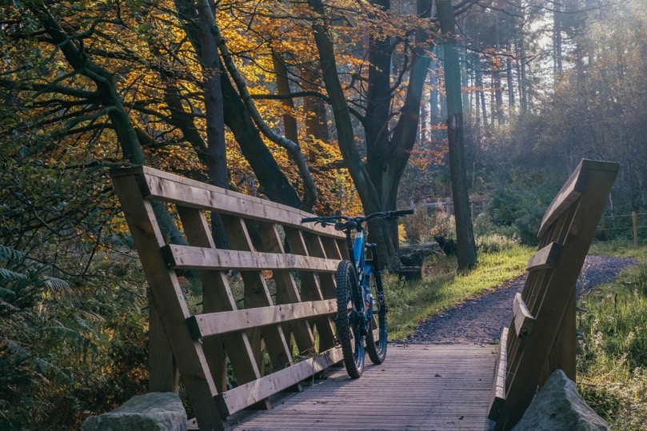
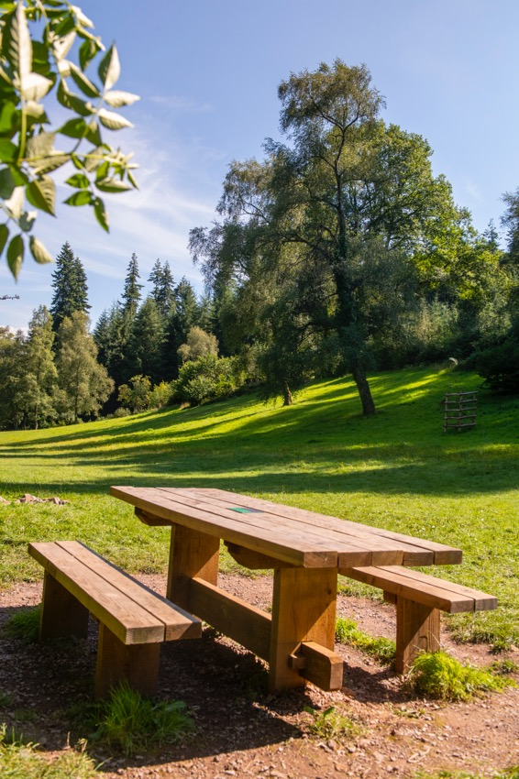

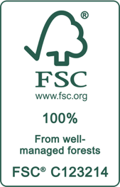
Wood
Symonds Yat, Herefordshire
Notes:
Wood is a beautiful, strong and a renewable natural material with endless uses.
Forestry England are the largest grower of sustainable timber in England, and our sustainably managed forests produce over a million tonnes of timber a year.
But The UK is the third largest importer of timber across the world.
When you shop for wood and paper products, always make sure to look for the FSC® or PEFC logos. This means they come from forests, like Forestry England’s, that are managed carefully for the future.
Q: How many things can you think of that are made from wood?
A: Paper, building materials, fences, sheds, bird boxes, pencils…

Slide 14
Back to...
Planning
Symonds Yat, Herefordshire
Notes:
What happens next all depends on the forest plan as the forest cycle continues.
Some parts of the forest might be replanted or left as open habitat for wildlife and different species of plants.
By looking ahead, we can give our forests the best chance to adapt to the changing climate. Forestry England use scientific research to predict how our forests will function in the future, so that the trees planted today will have the best chance of thriving. Forestry England are planting lots of new tree species that are predicted to cope better with changing climate conditions, including types of redwood, cedar, and maple.
Diverse forests are more resilient to climate change and tree diseases.

Slide 15
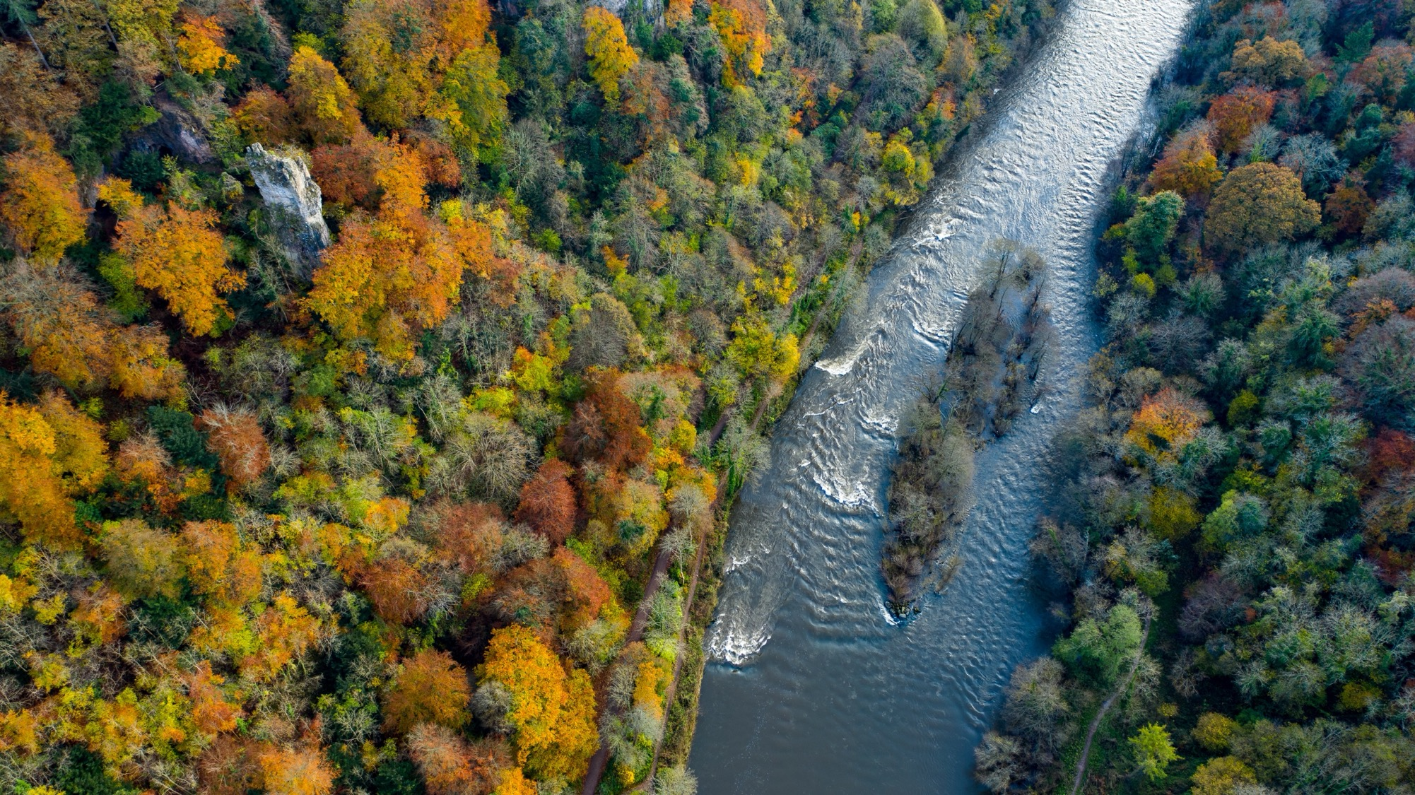
Sustainable
forest management
Notes:
Growing forests for sustainable timber is only part of the story.
The Forestry Commission was set up over 100 years ago in 1919, to grow timber for the UK. Due to increased demand for timber during WWI, by 1919 trees covered only 5% of the land. It’s now up to 10.3% of England and the government is aiming for 16.5% by 2050.
As well as a renewable resource, the nation's forests provide spaces for people to enjoy and to exercise, vital habitats for wildlife, and a means of capturing carbon to help mitigate climate change. We work hard to make sure we get the balance right.

Slide 16
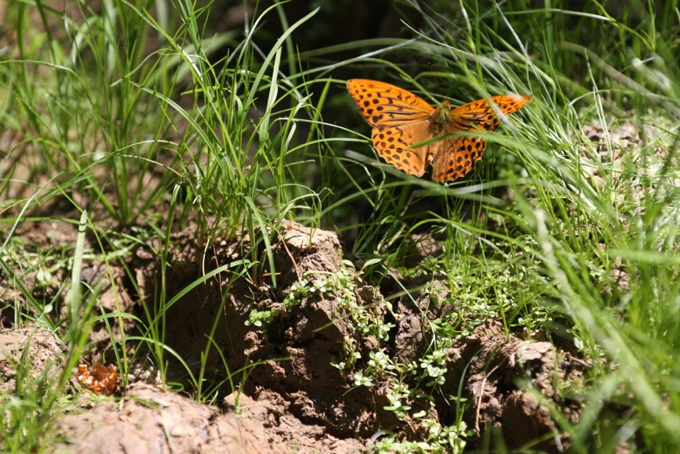
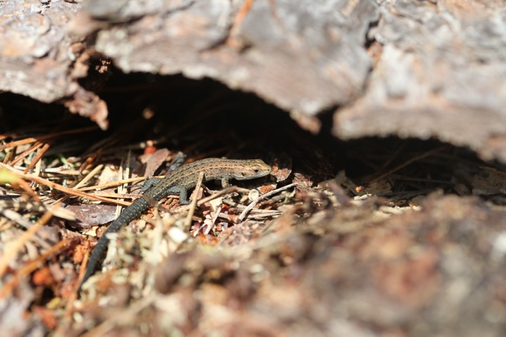
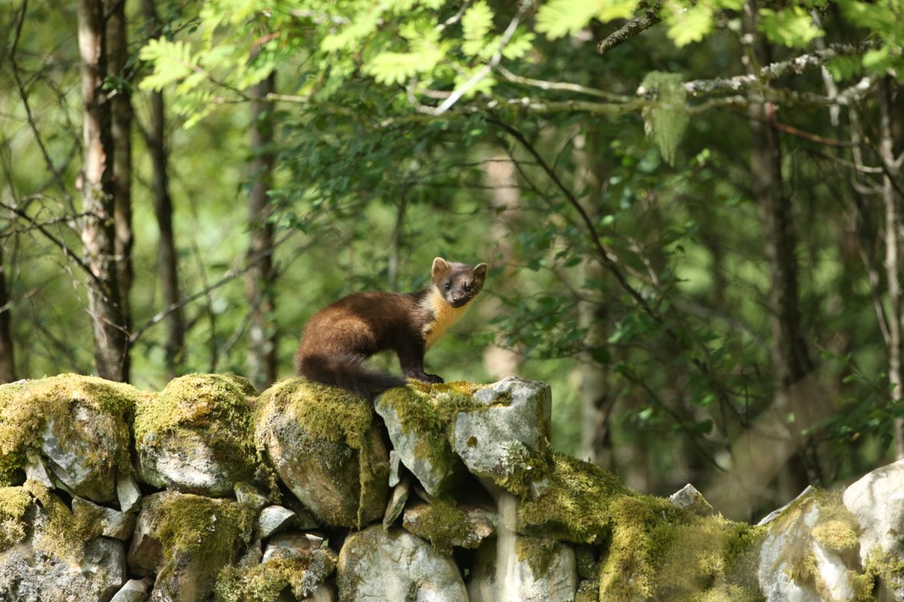
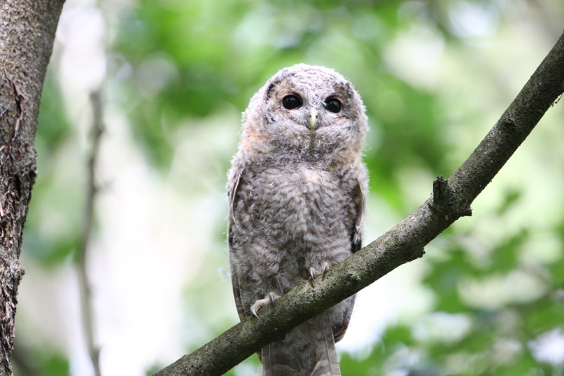
Forests for wildlife
Symonds Yat, Herefordshire
Notes:
Forestry England cares for some of the most valuable places for wildlife in the country and are working hard to increase biodiversity.
Forestry England forests provide more than a quarter of a million hectares of wildlife habitat, where over half of England's rarest species can be found.
Forestry England are returning missing creatures to our landscapes and recovering vital ecosystems.
Q: What animals do you think live in the forest?
A: There are too many to list but here's a selection:
Invertebrates: Insects (eg beetles, ants, butterflies, bees, wasps), spiders, woodlice, centipedes, slugs and snails.
Reptiles: Lizards, slow worms, adders, grass snakes
Amphibians: Frogs, toads, newts
Mammals: Foxes, badgers, squirrels, mice, hedgehogs, deer and pine martens.
Birds: Robins, blackbirds, blue tits, woodpeckers, nightjars, woodlarks, buzzards, red kites, ospreys, tawny owls.
From magnificent birds soaring above the trees, to tiny ants making nests below them, every creature is a part of the forest.

Slide 17
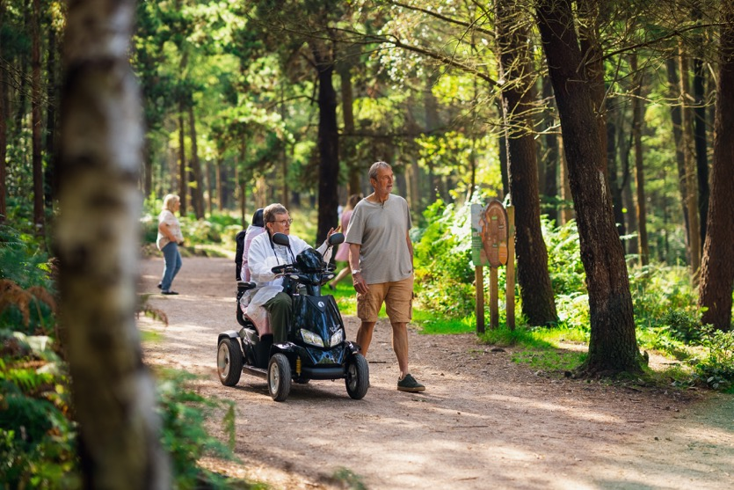
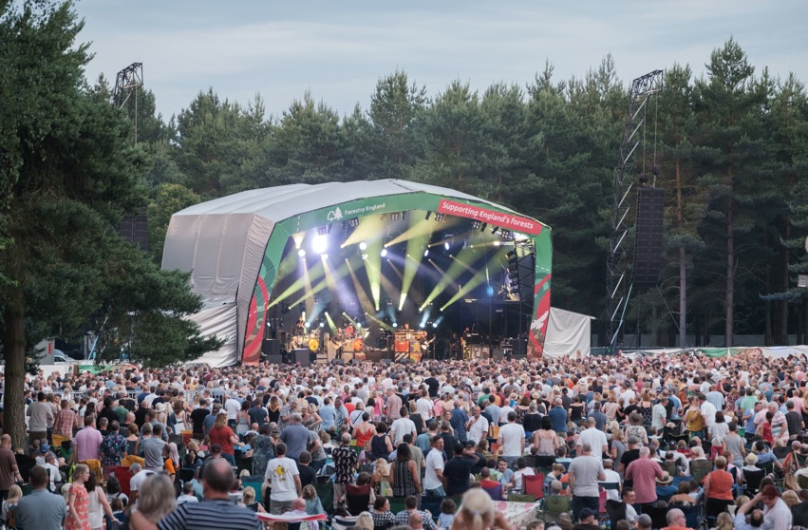
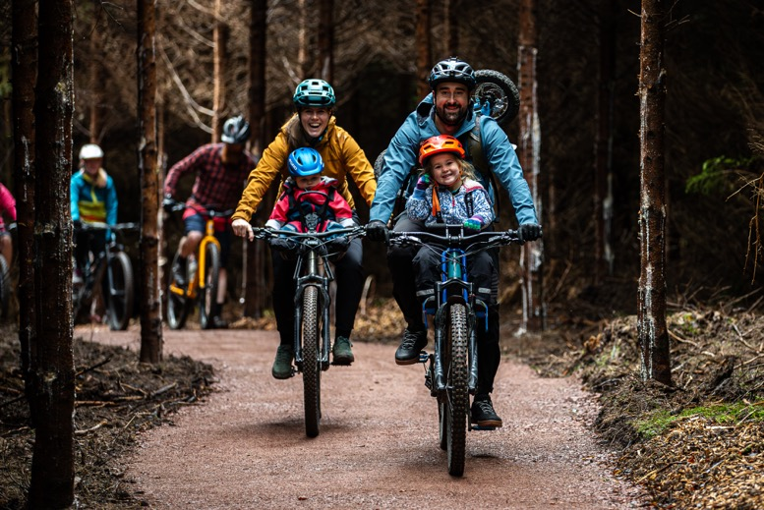
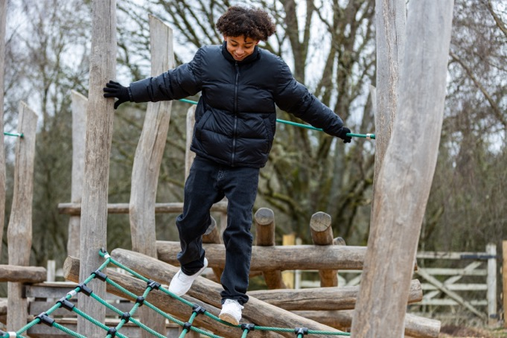
Forests for people
Symonds Yat, Herefordshire
Notes:
Forestry England want everyone to feel welcome and safe in the forest, so they can have adventures and feel the benefits of connecting with nature.
Forests are for leisure, wellbeing, exercising, spending time with friends and family or escaping from the busyness of everyday life.
Spending time outside each week in nature significantly improves our health and wellbeing.

Slide 18
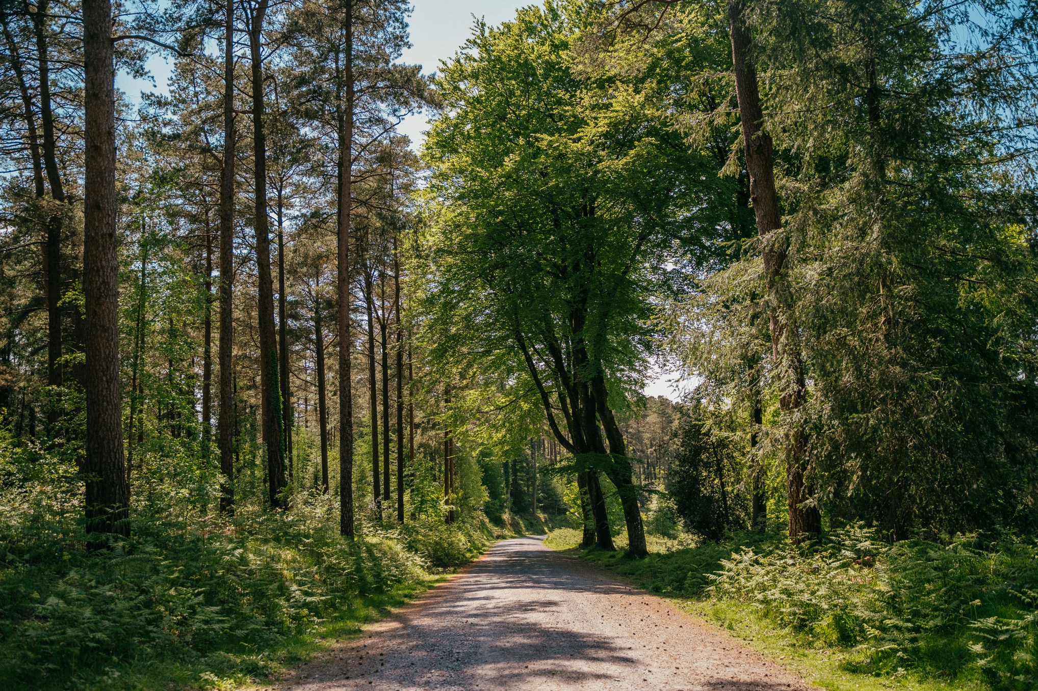
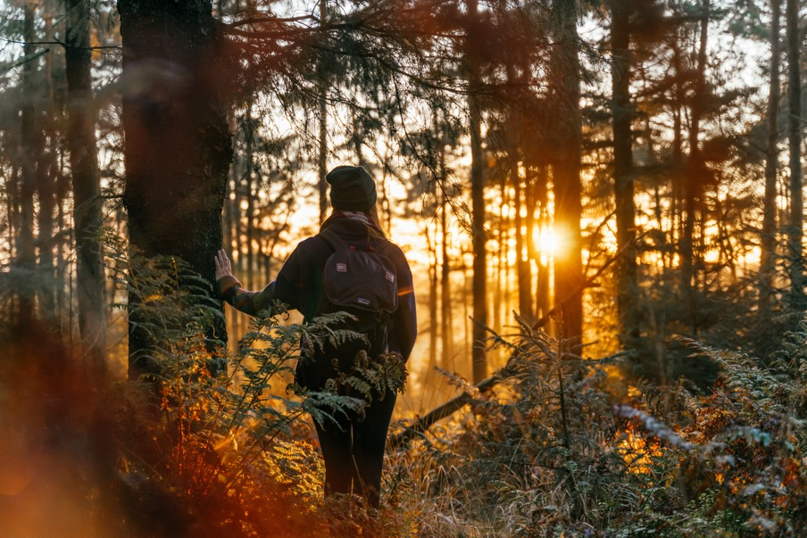
Forests
for the future
Notes:
Trees do so much for us, but we need to help them too.
Forestry England are researching, planning and creating resilient forests that will continue to grow for many years to come.
Q: What can we all do to help?
A: The forest code is a good place to start:
Protect and respect wildlife, plants and trees - When spending time in the forest, consider your surroundings and make sure that all plants and animals are left undisturbed.
Guard against all risks of fire - Dry weather makes it very easy for wildfires to start. Help prevent this by not lighting campfires, only use BBQs where allowed and make sure any cigarettes are put out and disposed of properly. If you see a wildfire dial 999.
Keep dogs under control - We know the forest is an exciting place for any canine companion! That’s why it's important to make sure your dog is under control at all times, for your dog's safety, yourself and the safety of other visitors.
Take your litter home - Don’t be a rubbish visitor! Litter is unpleasant for visitors but can also cause damage to the landscape and wildlife.
Make no unnecessary noise - Forests are a great place to escape the hustle and bustle of everyday life. Avoid disturbing wildlife and other visitors by keeping noise to a minimum. Ditch the loud music, any unnecessary shouting and revving of car engines and just enjoy the peace and quiet.
Take only memories away - Anything that belongs in the forest should stay in the forest. Respect the forest and the wildlife that lives there by leaving their home intact.
The forest is for everyone, please be aware of other visitors - From young families to adventurous bike riders and dog walkers to bird watchers; we want everyone to enjoy their visit to our beautiful forests. Be considerate of other visitors when moving around the forest. Why not offer a smile and friendly greeting? Everyone should feel welcome.

