Slide 1
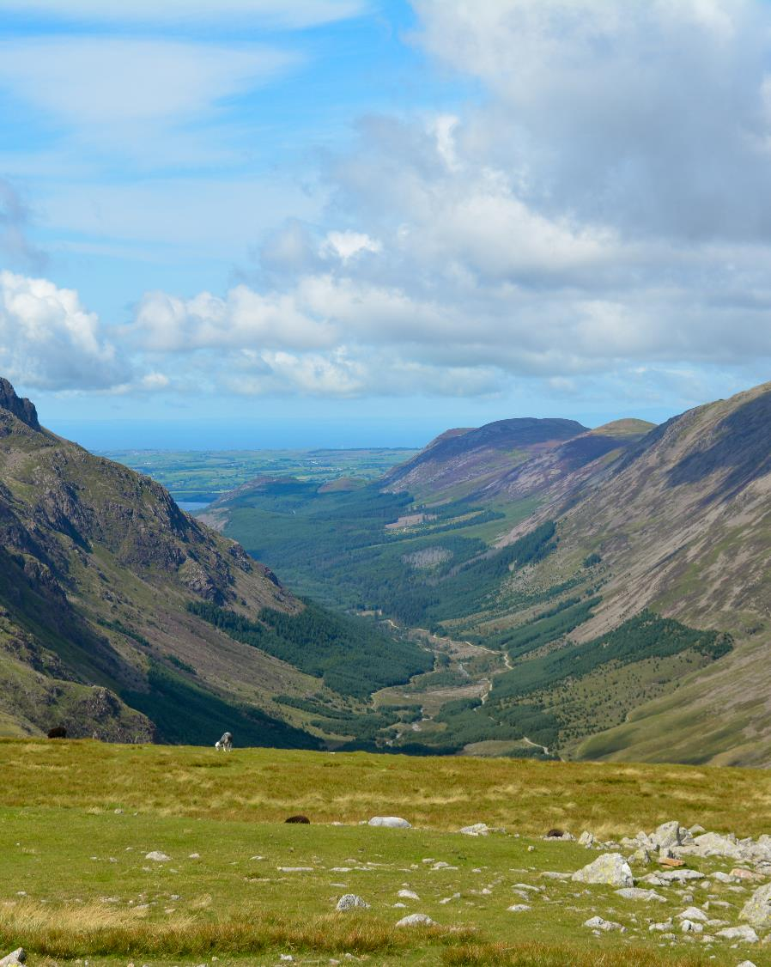
Landscape change
Notes:
This shows Ennerdale, a glaciated valley located in the western Lake District. The forest in this valley has been managed very differently over the past and is now part of a nature restoration project called Wild Ennerdale. You will find out more about the landscape changes that have taken place in Ennerdale in the second case study.

Slide 2
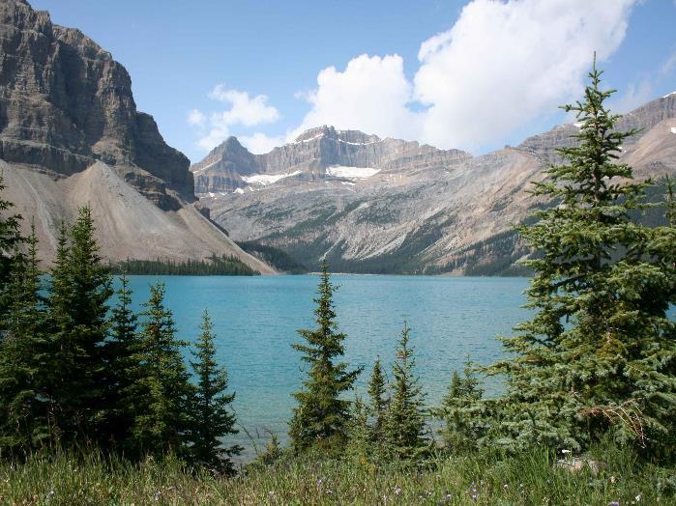
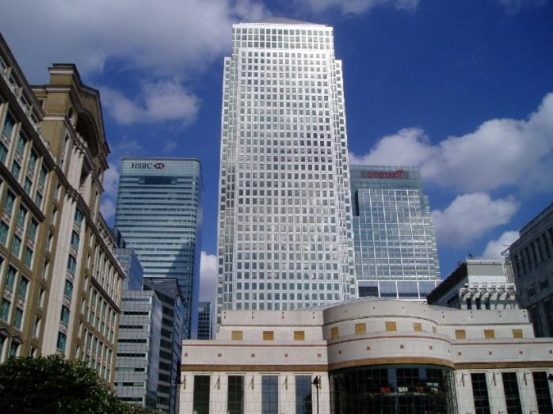
What is landscape?
Alice Lake, Rockies, Canada
Canary Wharf, London
Notes:
A landscape can be defined as ‘the visible natural and human features of an area of land’.
Many people consider the landscape to be a natural view in the countryside (mountains, the coast, forests). The left photo shows Alice Lake in the Rockies, Canada a glacially formed lake and popular tourist attraction today.
However, there are also urban/city landscapes (skyscrapers, religious buildings, parks) and industrial landscapes (factories, quarries, warehouses). The right photo shows Canary Wharf in London’s docklands.

Slide 3
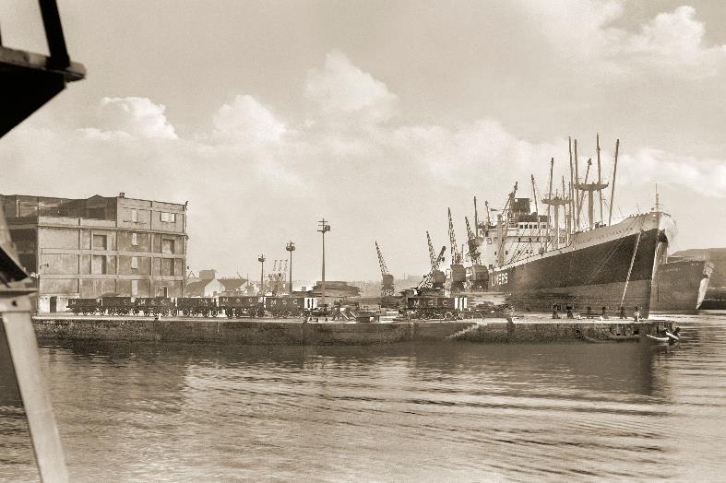
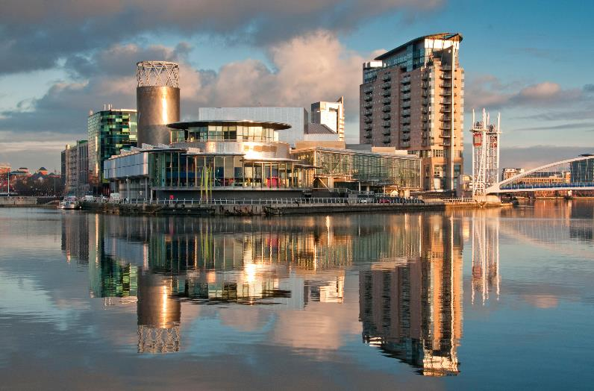
What is landscape change?
Salford Docks, Manchester in 1967
The Lowry Centre & Theatre, 2017
Notes:
For example, think about how landscapes are constantly changing. Think about how local landscapes change with the seasons.
Landscapes will continue to change over time. Green fields may be developed for housing or new roads, new woodlands may be planted, and urban landscapes may become greener.
These photos show Salford Quays in Manchester in both 1967 and 2017. The land has been transformed from a former industrial dockland into a modern commercial and residential area with shops, restaurants and galleries.

Slide 4
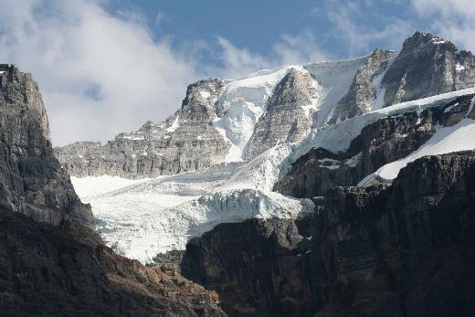
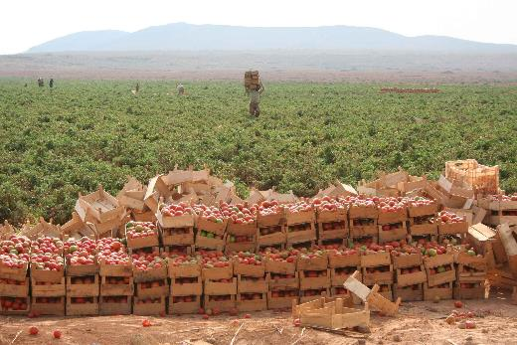
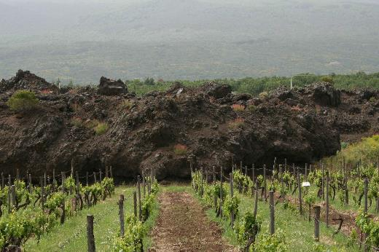
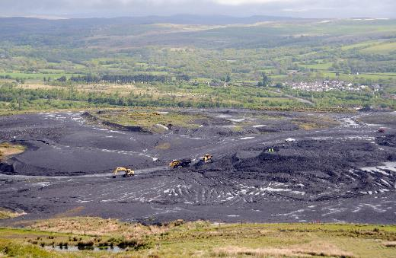
What causes landscape change?
Notes:
Physical and human processes interact to create landscape change.
Physical processes include tectonic activity such as volcanic eruptions, the action of rivers, ice, the sea, ecological succession and climate change.
Human processes include industrial development (quarries, factories), agriculture, urbanisation and infrastructure (roads, rail).
These photos show glaciers in Canada, a lava flow from Mount Etna (Italy), commercial irrigated farmland (tomatoes) in Jordan and opencast coal mining in South Wales.

Slide 5
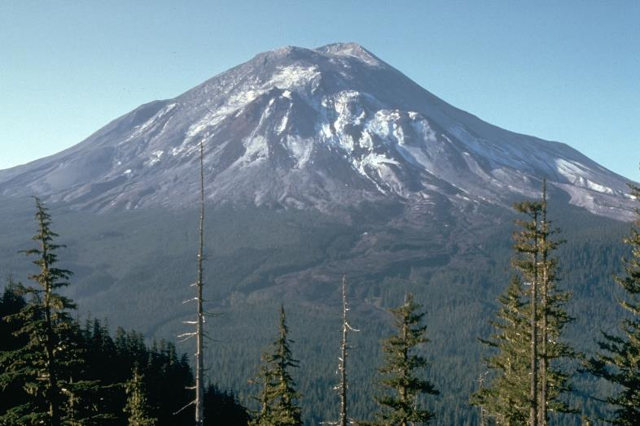
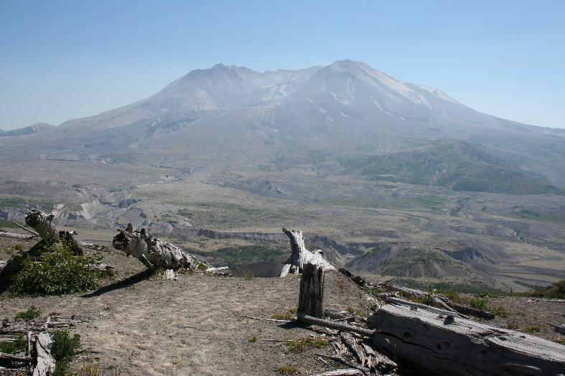
Landscape change: volcanic activity
Notes:
The left photo shows Mount St Helen’s before it erupted in 1980. The violent eruption wiped out huge areas of forest and deposited a great thickness of ash.
The right photo was taken in 2010, 30-years after the eruption, but you can still see the widespread devastation. Notice how the trees in the foreground have been torn from their roots by the power of the eruption.
In the distance you can see that some trees have begun to re-colonise the area. So in decades to come the landscape will change again.

Slide 6
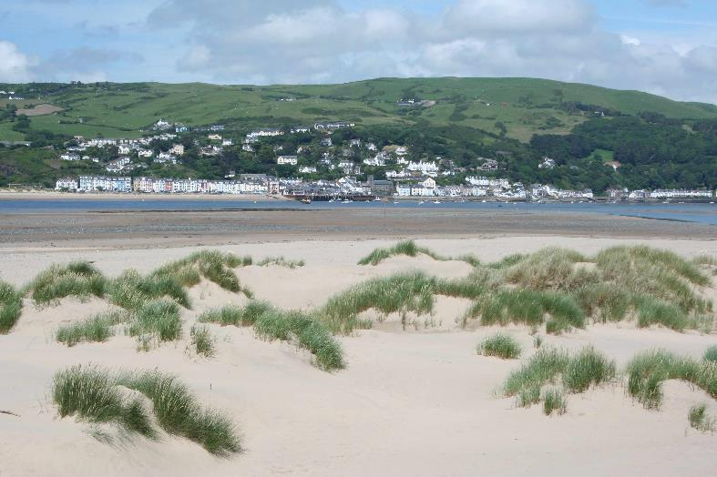
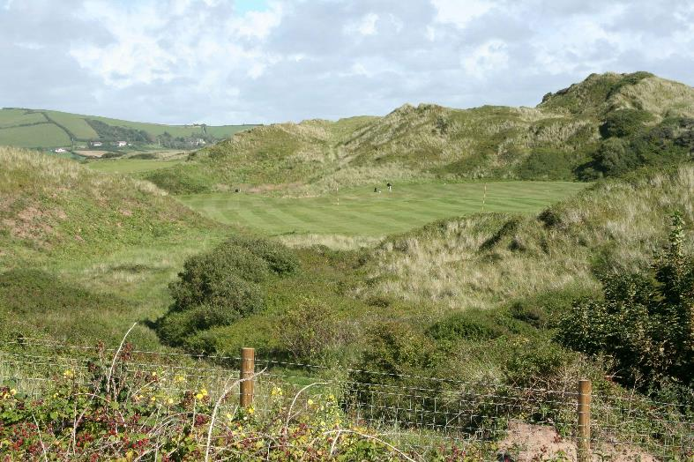
Landscape change: at the coast
Dyfi estuary
Braunton Burrows
Notes:
The left photo shows the Dyfi estuary and, in the distance, the seaside village of Aberdyfi (Gwynedd, Wales).
The wide estuary was formed as sea levels rose at the end of the last ice age about 15,000 years ago. Vast amounts of sediment were deposited. Since then, the river, waves, tidal currents and wind have re-worked the sediment to form mudflats, salt marshes and sand dunes. Over time, vegetation succession changes the sand dunes. Early species such as marram grass are succeeded by shrubs and eventually trees.
The right photo shows Braunton Burrows in North Devon. The small hills in the middle distance of the photo are ancient sand dunes, now colonised by grasses and shrubs.
Can you see a golf course in the centre of the photo? This shows how the natural sand dunes have been managed by people to create a new landscape.

Slide 7
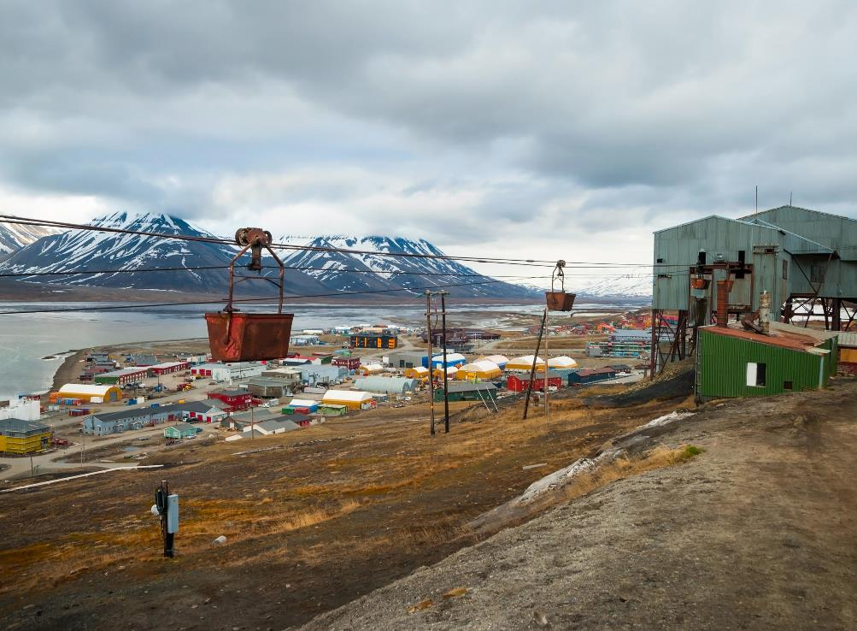
Landscape
change:
industrial
development
Notes:
This photo was taken in Svalbard, a Norwegian archipelago located in the Arctic. It is the most northerly inhabited area in the world.
Svalbard’s rugged, glaciated landscape is home to polar bears, Arctic foxes, and reindeer. The main settlement is Longyearbyen. This was developed as a coal mining settlement. The photo shows some of the industrial and port developments in the town.
The landscape across the water shows what this area would have looked like before it was developed.

Slide 8
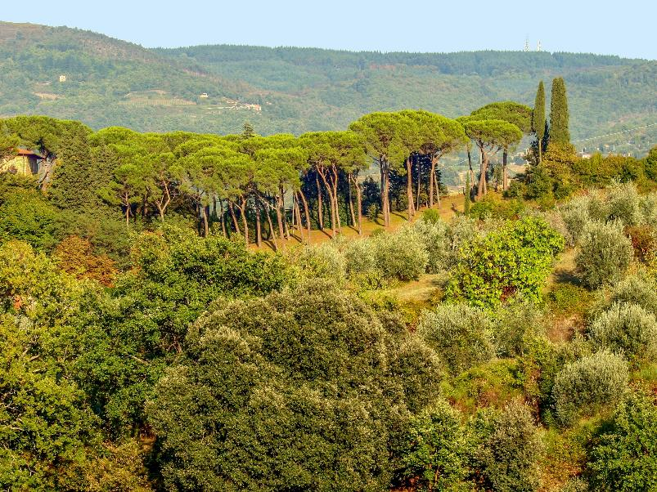
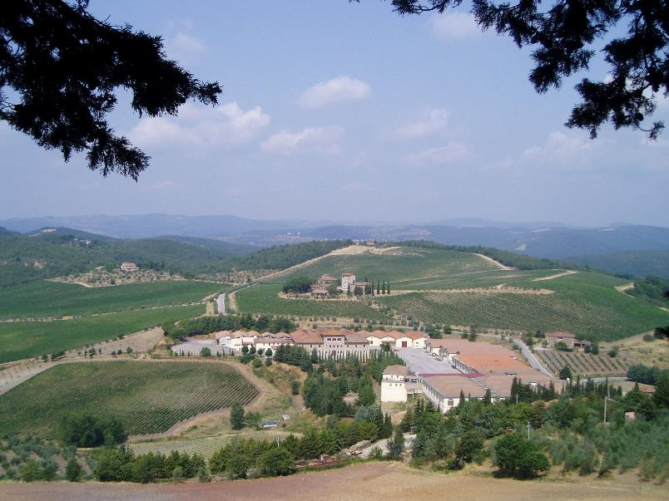
Landscape change: agriculture
Notes:
This rolling rural landscape is in Tuscany, Italy.
In the past, much of this landscape was as the left image shows, covered by shrubs and trees, such as pines and oaks. In much of Tuscany, this natural woodland has been cleared to make way for commercial farming, as shown in the right image. The hot and sunny climate is ideal for growing grapes, a type of farming called viticulture. Some areas have been planted with olive and citrus trees which are also well adapted to the physical conditions.

Slide 9
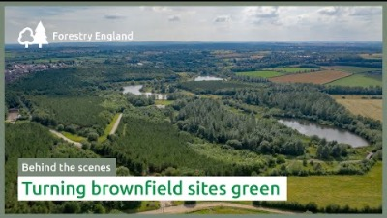
Landscape change: woodland creation
Notes:
Sence valley was previously a large opencast coal mine. The mine closed in 1996. The land was restored and in 1998 planted with 98,000 trees, transforming Sence Valley into a haven for wildlife and visitors.
Today, Sence Valley is a popular attraction for walkers, cyclists, horse riders and bird watchers.

Slide 10
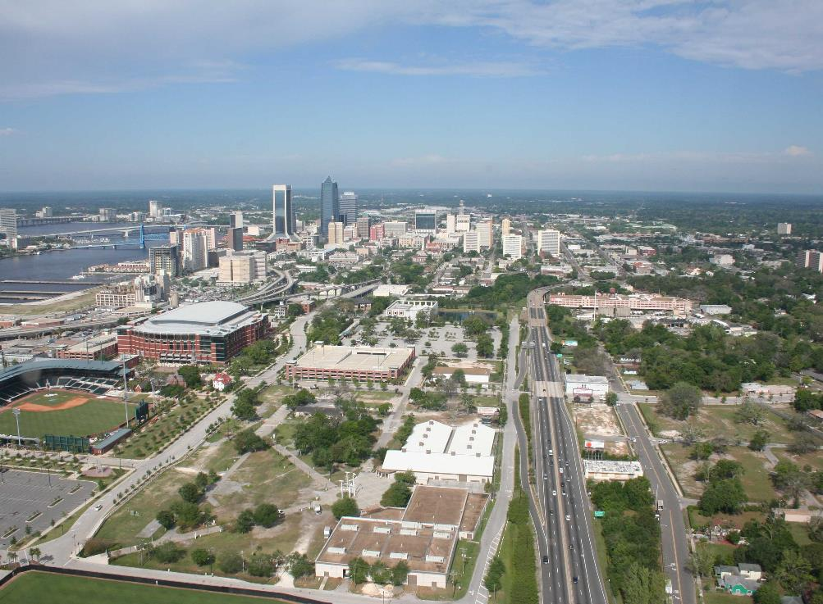
Landscape
change:
urbanisation
Google Earth
Notes:
This is an aerial photo of Jacksonville (Florida, USA). With a population of just under one million, it is the state’s most populous city.
Jacksonville has spread over a vast area either side of the St. Johns River. This outward city expansion is called urban sprawl.
In the past, much of this area would have been natural woodland and wetlands.

