Slide 1
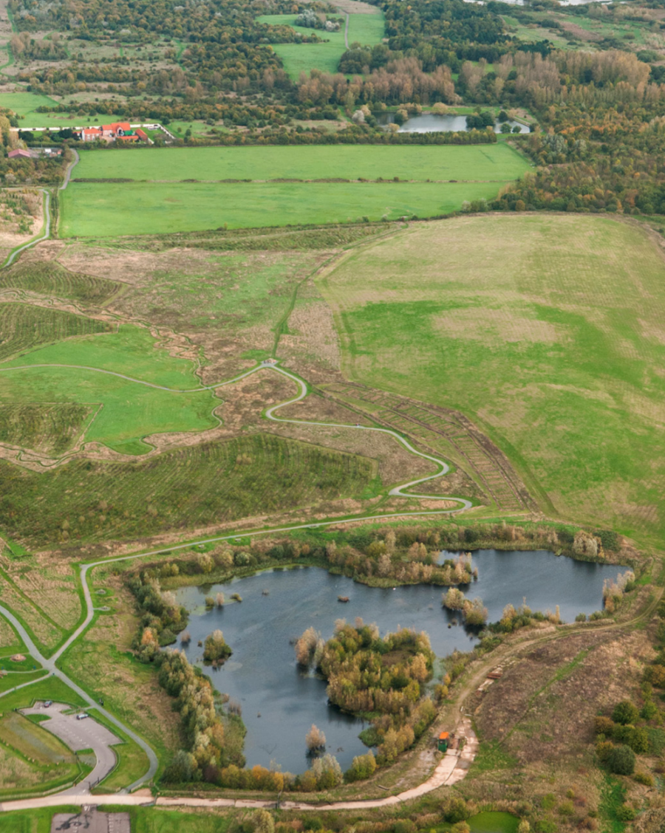
Thames Chase Community Forest

Slide 2
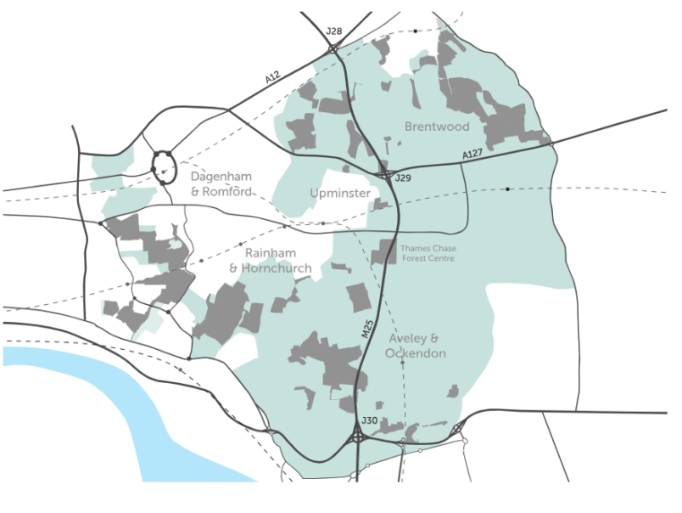
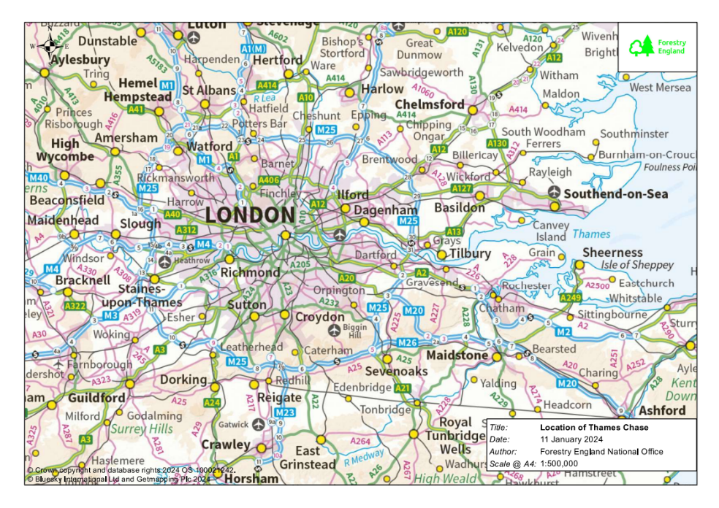
Where is Thames Chase
Community Forest?
Thames Chase Community Forest site
Notes:
The Thames Chase Community Forest covers over 10,000ha of land in east London and south Essex.
Established in 1990, the community forest comprises of 47sites, many of which are linked together to form wildlife corridors. Since 1990, 1.3 million trees have been planted.

Slide 3
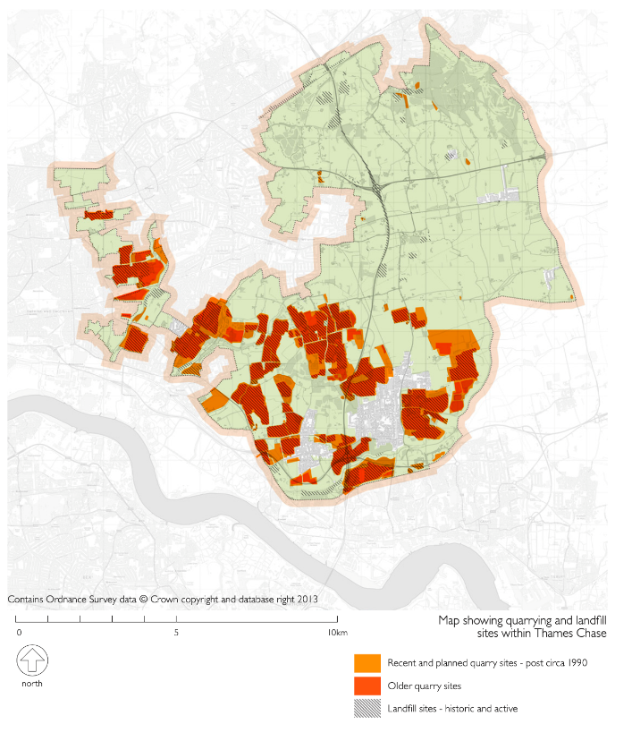
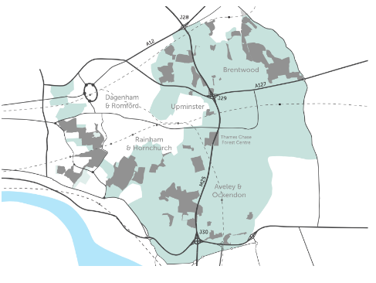
Industrial
landscape of the past
Notes:
In the past, this area was quarried for sand and gravel. Much of it was used in the construction industry as London expanded. Some was used in road building, for example, in constructing the nearby M25 in the 1970s and 1980s.
As a result, the area was pock-marked with quarries. Some abandoned quarries became re-purposed as landfill sites. When full, they were covered by layers of soil (fill) and then used as low-quality farmland. It is some of this land that has been recently planted with trees to create the community forest, which can be seen with the two maps side by side.

Slide 4
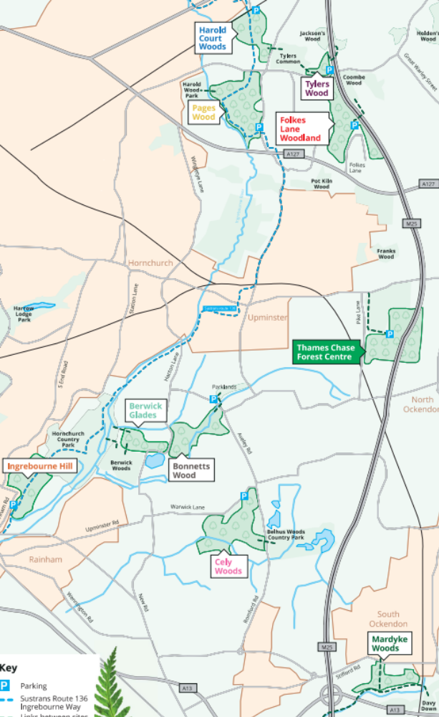
How is Thames Chase
managed?
This map shows the sites within Thames Chase Community Forest that Forestry England manages.
Notes:
Forestry England is one of several partners that are involved with the management of the Thames Chase Community Forest. Other partners include local authorities, environmental and heritage organisations.
The Thames Chase Trust is responsible for the overall landscape vision and strategic planning. Forestry England is responsible for woodland creation. Today, Forestry England manage 10 woodland sites developed on greenfield and brownfield land to improve connectivity for people and habitats as part of landscape scale restoration in the area.
Forestry England continues to work with partners to create new woodland in the area, including at Hole Farm in Essex where a collaboration with National Highways will transform a nearly 100ha farm into a new community woodland.

Slide 5
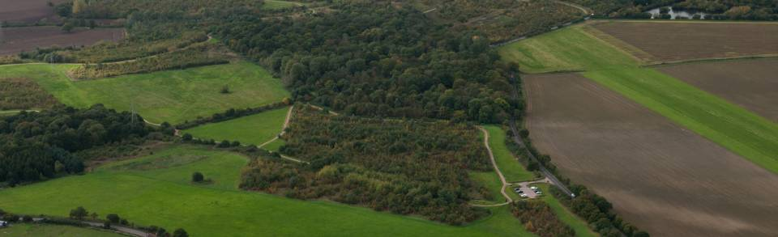
Objectives
To protect, improve and expand the woodland character of the community forest
To maintain the natural integrity of the community forest’s air, land and water including wildlife
To develop a connected network of links and accessible, vibrant greenspaces throughout the community forest
To integrate climate change adaptation and mitigation responses into the developing community forest
To use the community forest to improve local health and wellbeing, volunteering, learning and employment
To enable effective partnership working from national to local level to maximise impact of available resources
Notes:
These objectives explain what the community forest aims to achieve.

Slide 6
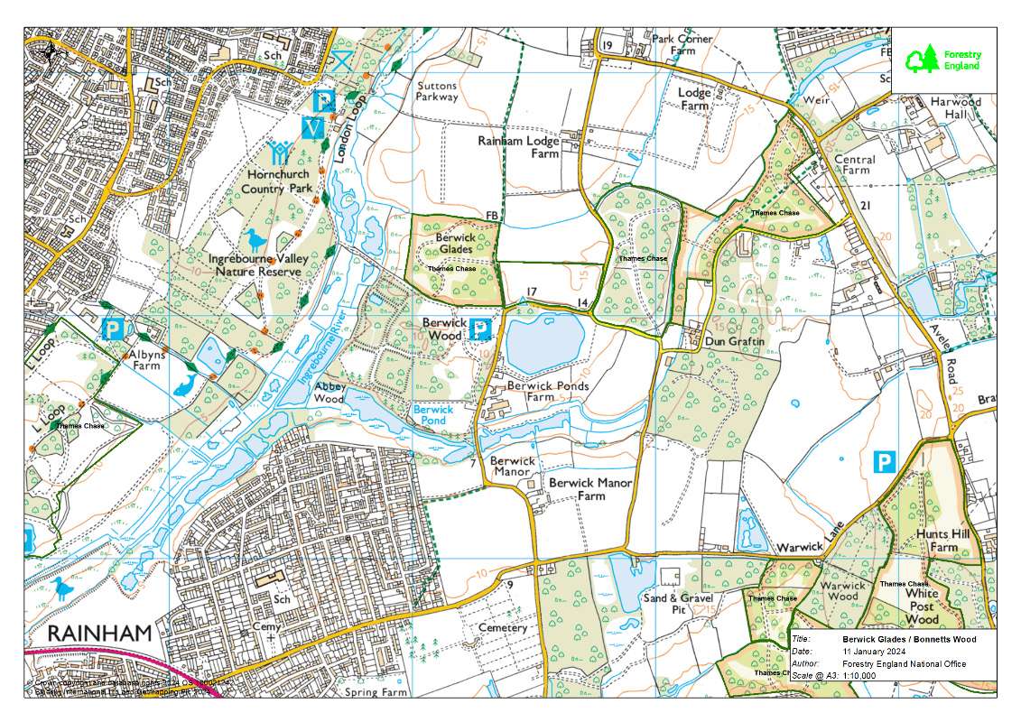
Thames
Chase Case Studies
Berwick Glades Extension
Berwick Glades
Bonnetts Wood
N
Bonnetts Wood extension
1 km
Notes:
This slide shows the location of the woodland sites that form the focus of this resource.

Slide 7
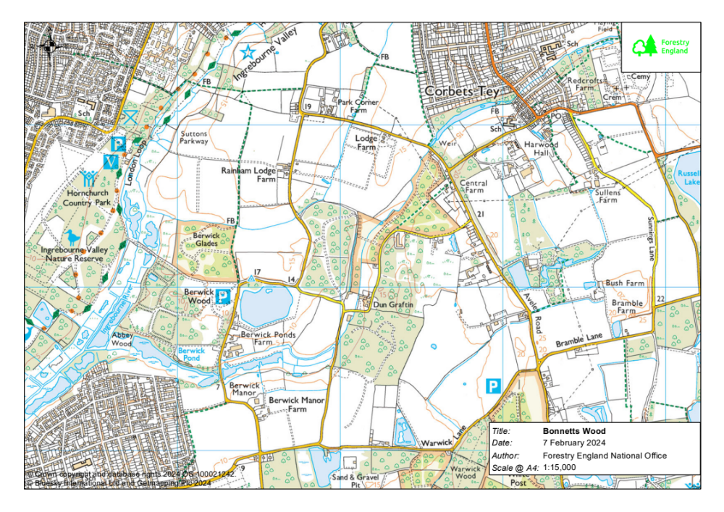

The story
of Bonnetts
Wood
The original woodland, planted in 2003, on former agricultural land.
Berwick Glades Extension
The extension, planted, in 2013, on a former landfill site.
N
1 km
Notes:
Bonnetts Wood is a 33ha site which was planted in two sections.
The first section, planted in 2003 on former agricultural land previously used as rough grazing for livestock.
The second section was a brownfield site, formerly a sand and gravel quarry (1950s-1960s). When quarrying ceased, it became a landfill site, backfilled with various waste materials including builders’ rubble from London. By 1981 much of the site was derelict and classed as damaged land. Ingrebourne Valley Ltd bought the land in 2005 and in 2008 they started working with Forestry Commission (now Forestry England) to restore the land. In 2010 surplus excavated material was imported to regenerate the land.
In 2013, the Forestry Commission, who now manage the land, began creating more woodland on the Bonnetts Wood extension and opened the land to the public.

Slide 8
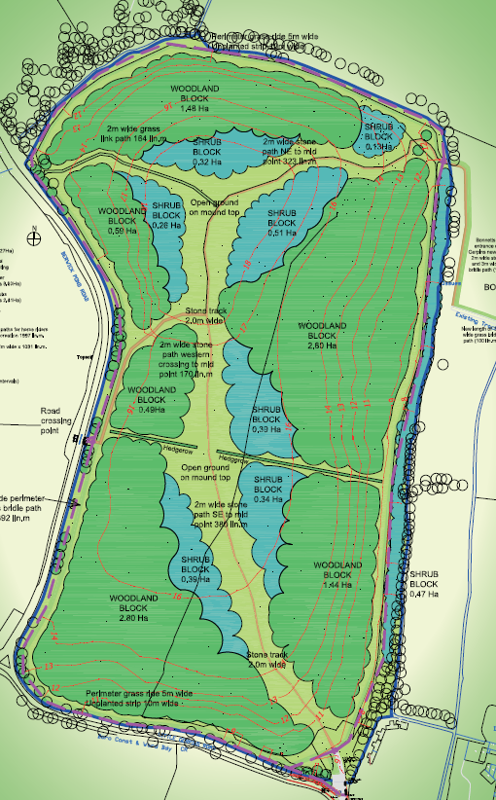
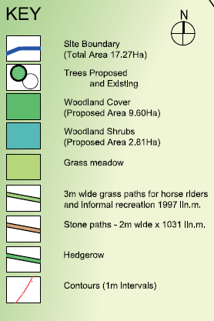
The planting of Bonnetts Wood extension
Notes:
This plan shows the extension to Bonnetts Wood.
In 2013, the Forestry Commission planted over 27,500 new trees and shrubs enlisting the help of the local community during tree planting days.
Gates, paths and benches were installed to allow access for the local community.

Slide 9
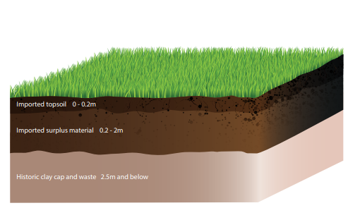
Understanding the conditions
Notes:
To ensure that the right trees were planted for the conditions, so that they would thrive and give all of the benefits for the community, various surveys were carried out, including soil testing. Remember, a lot of soil had been imported from elsewhere to restore the land.

Slide 10
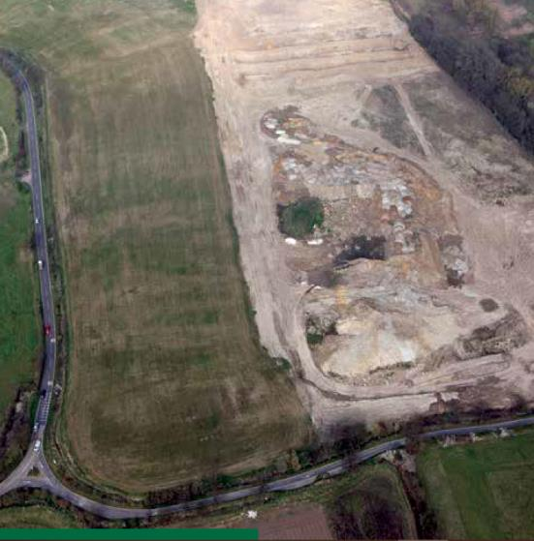
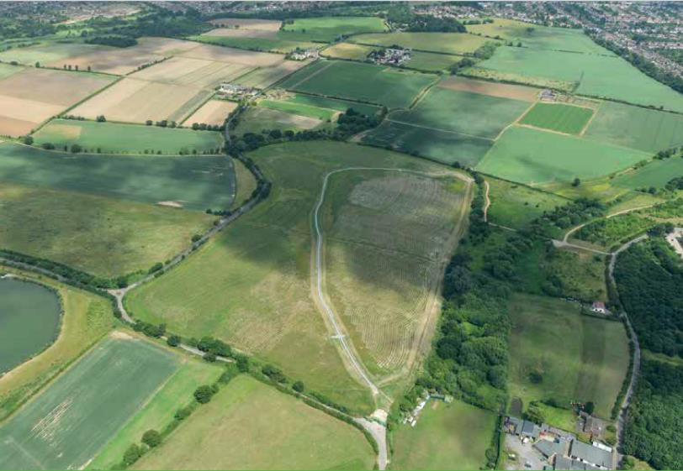
Bonnetts Wood extension:
before and after
During reclamation
Planted with trees
Notes:
These images show the extension to Bonnetts Wood on the brownfield site, a former quarry and then landfill site.
The left photo shows reclamation and landscaping of the landfill site prior to planting in 2013. The right image shows the newly planted trees.

Slide 11
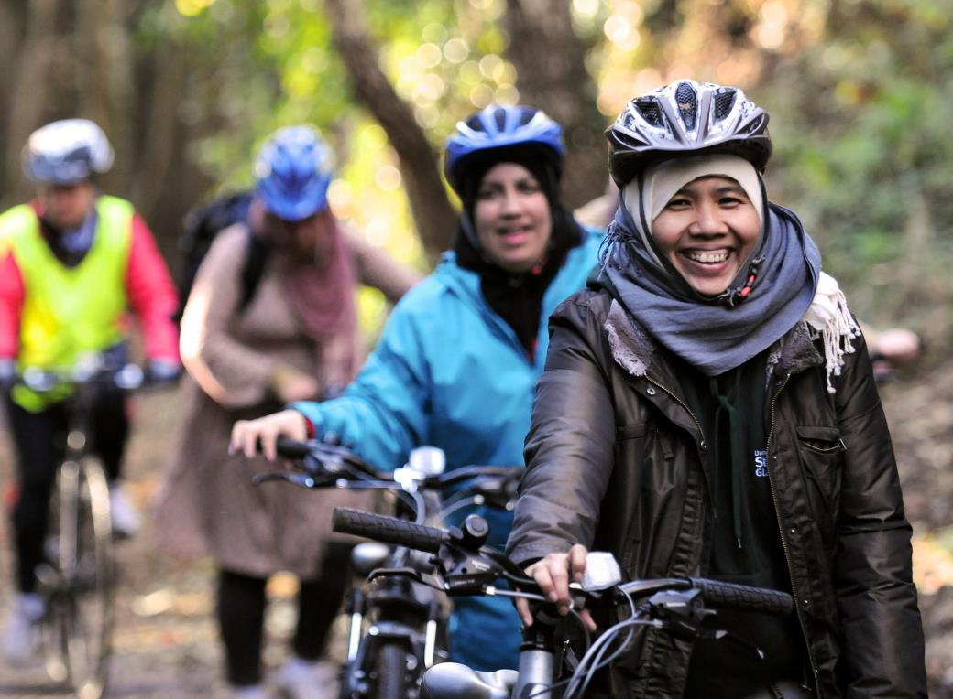
Bonnetts
Wood:
community
forest
Notes:
Bonnetts Wood has brought many benefits to people and nature:
Former inaccessible derelict and damaged land has been transformed into attractive and accessible community woodland.
There are opportunities for walking, running and cycling on the pathways and horse riding as well a community activities, wellbeing initiatives and volunteering opportunities.
Biodiversity has benefited from the planting of trees, shrubs and hedgerows providing new habitats.
The mixture of broadleaved tree species planted and managed for woodfuel, is predicted to sequester around 1,196 tonnes of carbon dioxide over a 20 year rotation.

Slide 12
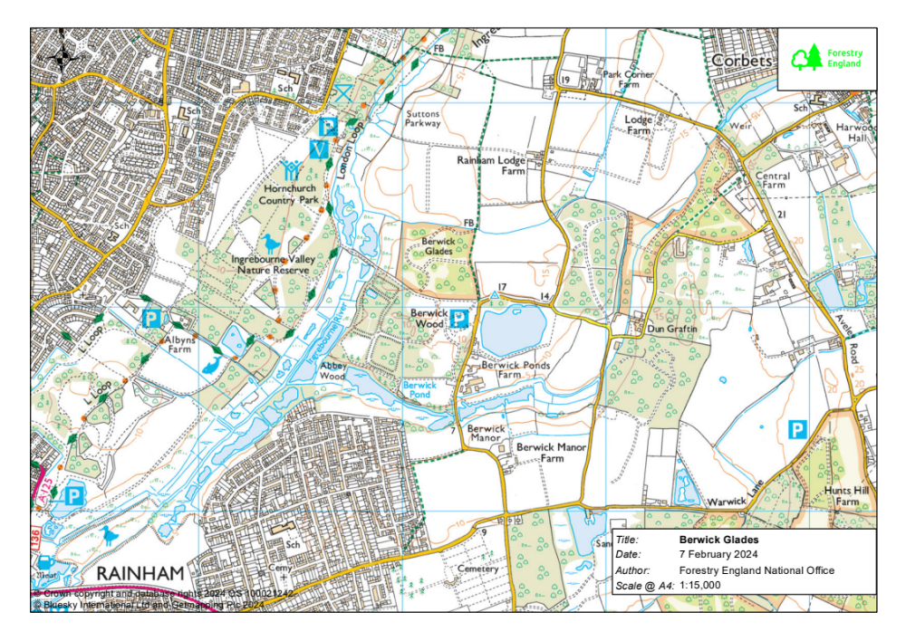
The story
of Berwick
Glades
Berwick Glades
N
1 km
Notes:
This slide shows an OS map of the area, locating Berwick Glades. The site is well connected by footpaths to Hornchurch and Rainham.

Slide 13
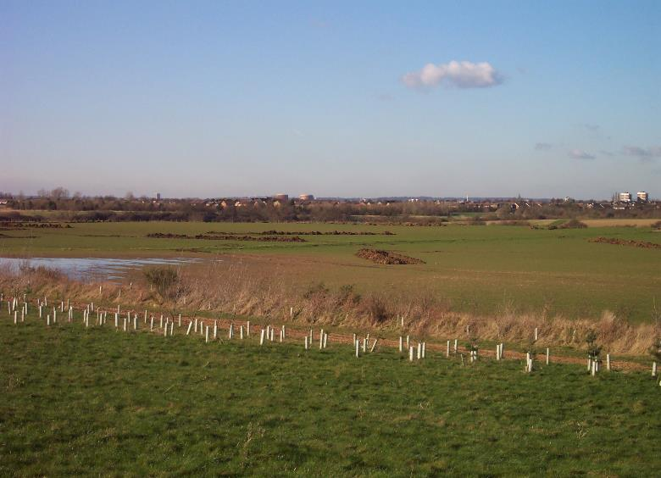
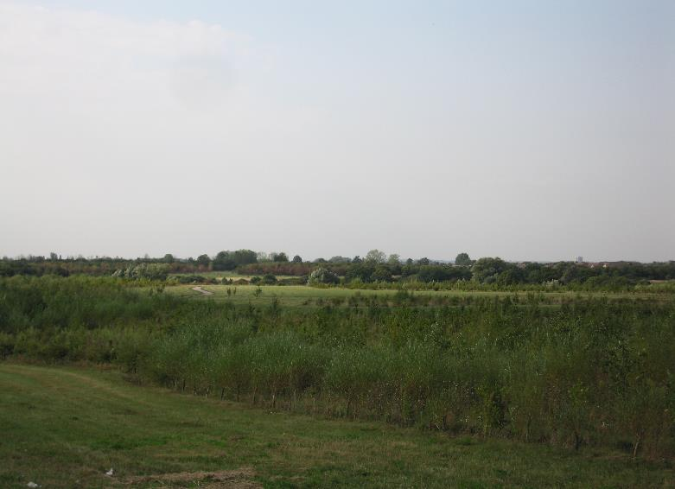
Berwick Glades: before and after
During planting
Growing forest
Notes:
Berwick Glades is a former quarry and restored farmland planted by the Forestry Commission (now know as Forestry England) in 2003. Open areas (glades) have been created between the newly planted trees to provide views of Ingrebourne Marshes and create wildflower meadows. A surfaced path winds its way through the wood and there are benches and picnic tables.

Slide 14
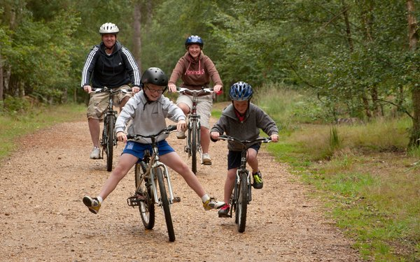
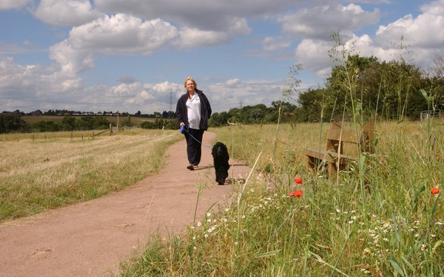
Berwick Glades: community forest
Notes:
The local community enjoy walking and cycling in Berwick Glades.
The right image shows the sorts of glades that are present, where grasses and wildflowers complement the areas of woodland.

Slide 15
The story
of Berwick
Glades
extension
Berwick Glades Extension
N
1 km
Notes:
The OS map shows the location of Berwick Glades extension, the site of an old quarry and landfill.
Owned and restored by Ingrebourne Valley Ltd, the land is now managed by Forestry England who have planted over 10,000 trees, many during special community planting days. The site opened to the public in 2019.
Bonnetts Wood | Forestry England
Berwick Glades | Forestry England

Slide 16
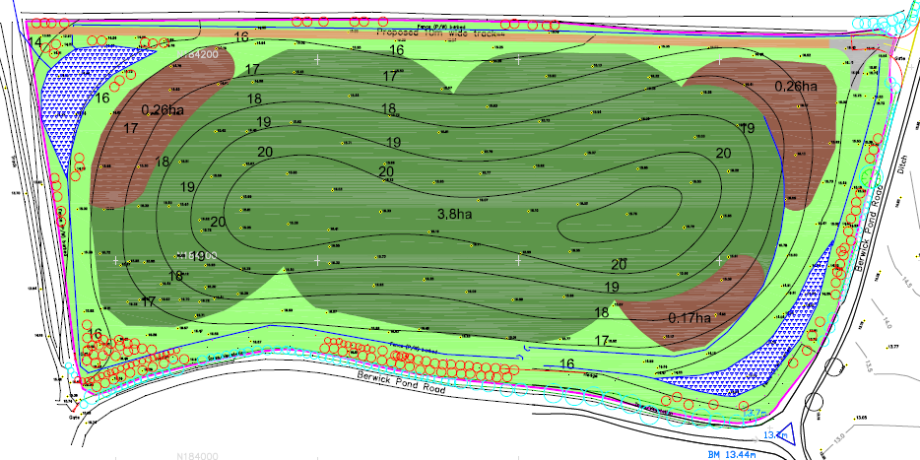
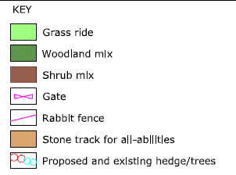
The planting of Berwick
Glades extension
Notes:
Most of the area has been planted with mixed woodland tree species. The wetter corners are planted with shrubs, more tolerant of the damper conditions. The perimeter rabbit fence helps to protect the young plants.
Over 1000 native woodland trees were planted with the support of volunteers.

Slide 17
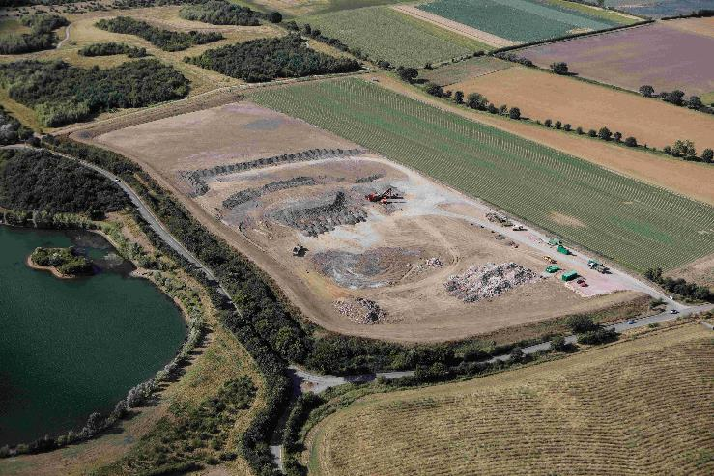
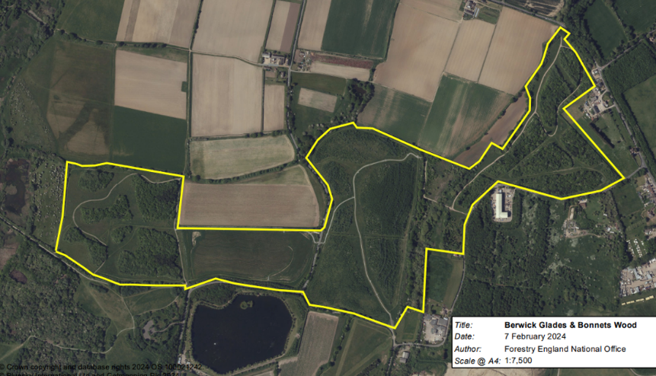
Berwick Glades extension:
before and after
Quarrying and
land restoration
Forest corridor linking Berwick Glades
with Bonnetts Wood
Berwick Glades
Bonnetts Wood
Bonnetts Wood extension
Berwick Glades extension
Notes:
These photos show changes in the landscape at Berwick Glades extension.
The left oblique aerial photo shows quarrying and land restoration at the site.
The right satellite photo shows the newly planted forest and illustrates the importance of Berwick Glades extension in connecting Berwick Glades with Bonnetts Wood.

Slide 18
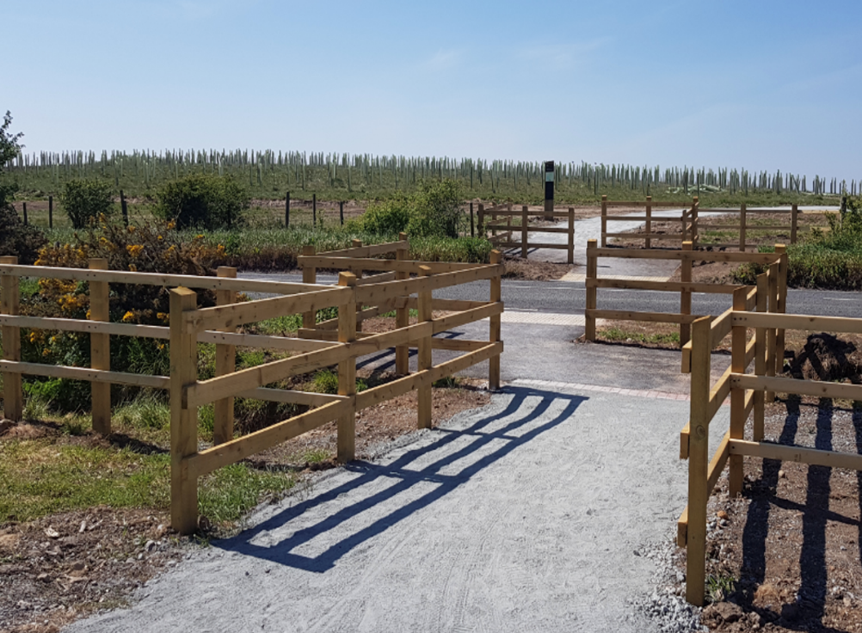
Berwick Glades extension:
community
forest

