Slide 1
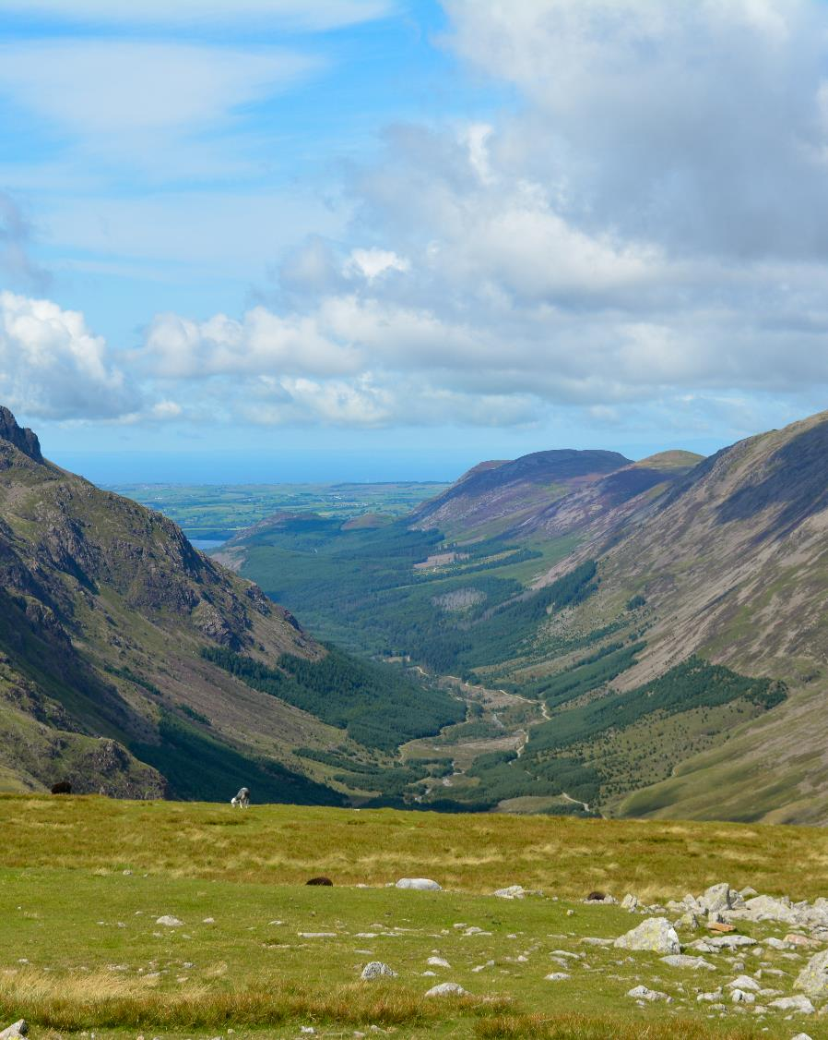
Wild Ennerdale
Notes:
Explore themes such as remoteness, lack of visible modern infrastructure, mosaic landscape, tranquillity, scale of mountains, importance of water – the river and lake.
Key features:
• It is a typical U-shaped glacial valley
• Cultivated land on the valley floor
• Forested slopes
• Meandering river
• Lake

Slide 2
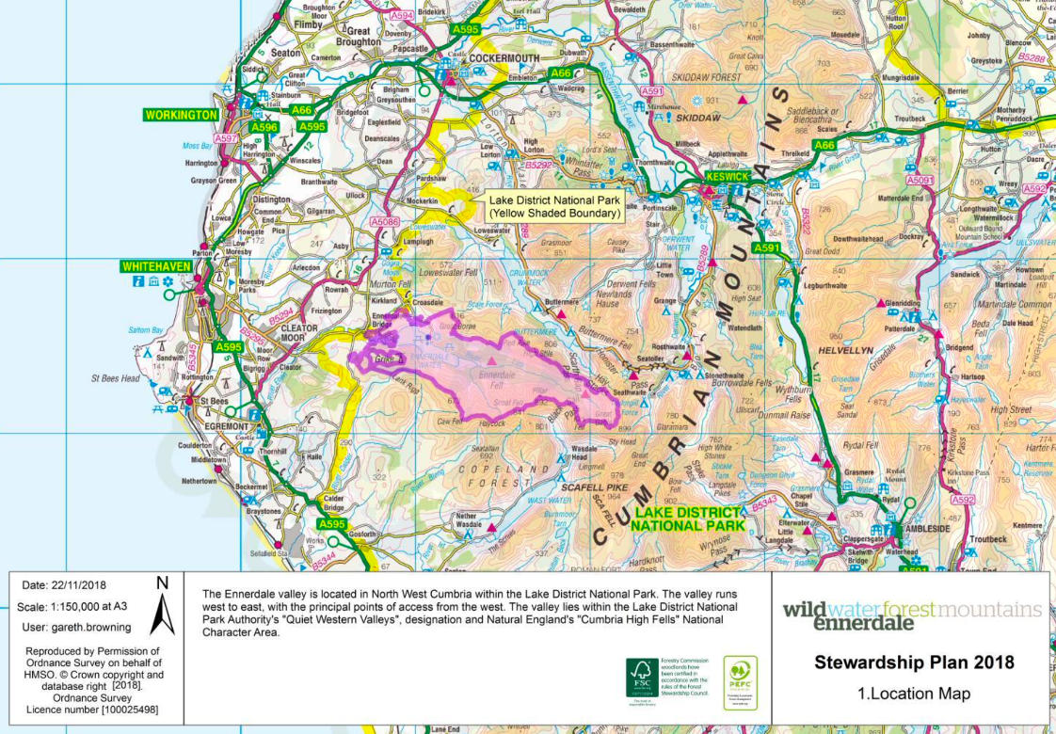
Where is
Ennerdale?
Notes:
Ennerdale is shown as the area bounded by the thick purple line. Notice that the valley is on the western side of the Lake District, inland from Whitehaven at the coast.

Slide 3
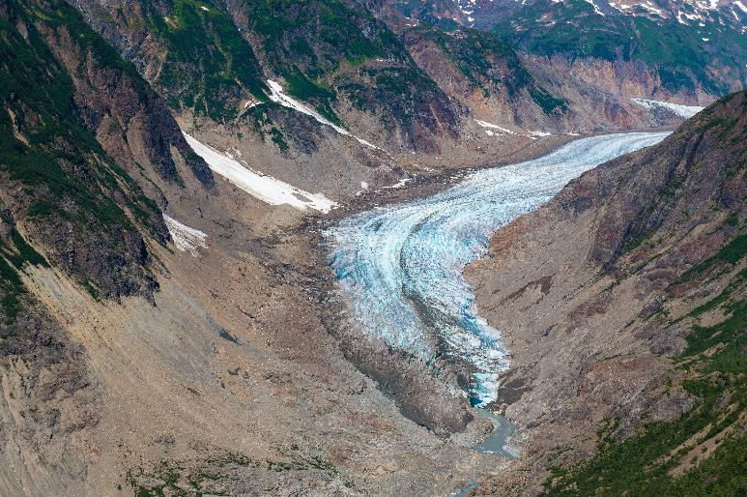
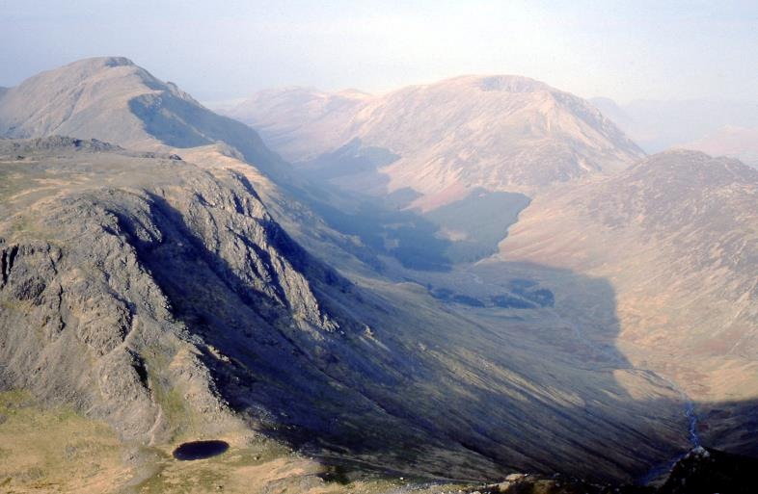
How has Ennerdale’s landscape changed?
Photo credit: Peter Rydall
Notes:
Around 20,000 years ago, at the height of the last Ice Age, much of the Lake District was covered by ice. Ennerdale was carved by a huge and powerful glacier.
At the end of the last Ice Age, about 10,000 years ago, the ice melted to reveal the sculpted landscape beneath.
This left a glacial lake which the glacier gouged out a depth up to 60m. The west end of the lake filled with material from the glacier streams and is only 10 to 15m deep. Hydrologically the lake is in fact almost 2 lakes.
The left photo shows a present day valley glacier in British Colombia. The Lake District may have looked like this towards the end of the Ice Age. Notice that although the valley glacier has shrunk in size there is still ice coming down the mountain sides from higher altitudes, where is colder.
The right hand photo shows the U-shaped valley resulting from glacier erosion.

Slide 4
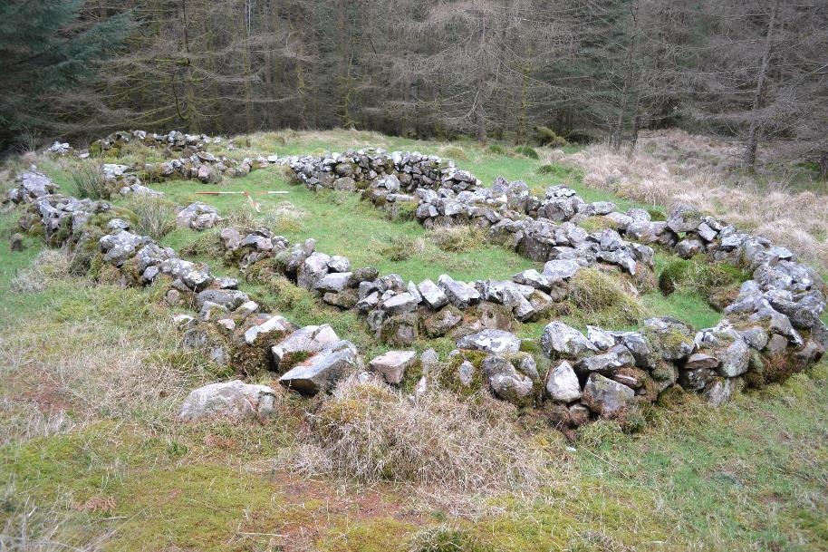
How has Ennerdale’s
landscape changed?
Click here to see a timeline of key points in Ennerdale’s history
Click here for some historic photos of Ennerdale
Notes:
As the climate warmed, forests of oak, alder and birch colonised the area. From about 3,500 years ago people began to manage the area. Much of the native forest was cut down to create farmland. Since then, other demands on the land have included iron ore and lead mining, water abstraction and commercial forestry.
Ennerdale is the best example of a settled medieval valley in the Lake District National Park. It has over 500 historic features where you can see how medieval people lived and worked. In addition, the valley has examples of iron age and prehistoric land use, initially providing just shelter and food, then products such as wood, meat and wool.
This photo shows the remains of a medieval twin walled longhouse.

Slide 5
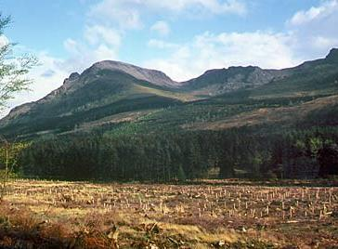
From natural
woodland to
plantations
Notes:
The forest present in Ennerdale today dates from 1925 onwards. During the first world war, timber was a key building material for planes, tanks, pit props etc which reduced the UK forest cover to just 5%. After the war the Forestry Commission was set up by Government to plant and organise the future timber supply and provide employment so rural communities could thrive again. By 1934, 300 local people were employed in forestry at Ennerdale.
The spruce and larch conifer trees which were planted formed a dense canopy with little light reaching the ground. Covered by a thick layer of acidic pine needles, which decompose very slowly, the forest floor was largely devoid of other plants and biodiversity was low.
These forests were managed mainly for timber and harvesting traditionally involved clearfelling (removal of all trees over a large area). The photo from 1993 shows recently planted tree saplings on the valley floor.

Slide 6
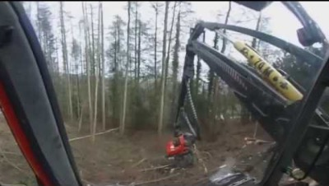
Harvesting
Notes:
Historically the first trees felled in the valley were felled by hand with an axe and large cross cut saw. A horse or a basic tractor would extract the timber to the road.
Harvesters were then introduced. These cut the trees near ground level, remove any branches and trim the trunk to a set length. A forwarder machine then stacks the timber near the roadside ready for extraction.
Just as the way trees are felled has changed so has the way the forest is managed. Today the forest is managed for multiple objectives including nature, wildlife and biodiversity. Timber harvesting today has to consider protecting nesting birds, breeding squirrels, the quality of water and public access.

Slide 7
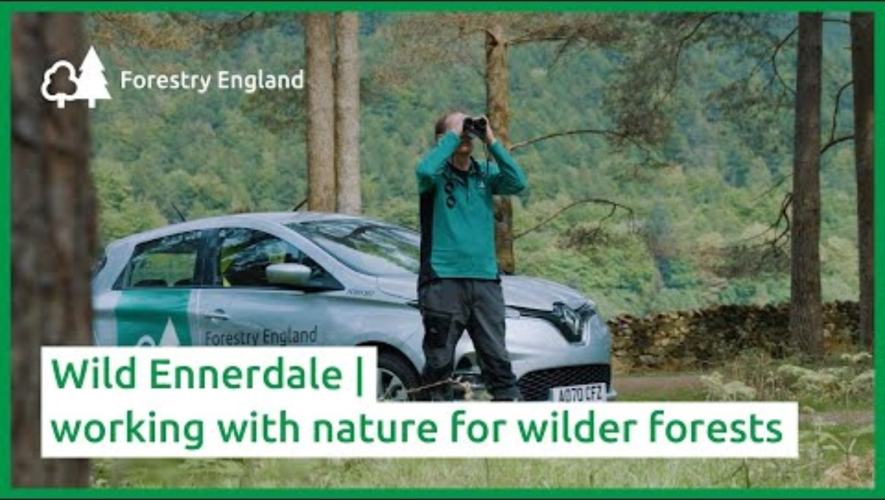
Notes:
Wild Ennerdale is now a superb example of natural process-led land management. It represents a new approach to managing for nature recovery at a landscape scale.
In 2006, the first Wild Ennerdale Stewardship Plan (WESP) was launched by Forestry England, National Trust, United Utilities and Natural England.
The latest Stewardship Plan (2018-2028) aims to balance the social, environmental and economic demands in the area. Through regeneration and by promoting natural processes, Wild Ennerdale will be more resilient to future changes in the climate.
Home to some of England’s most vibrant and varied natural environments, Wild Ennerdale is one of the longest running wild land restoration projects in the UK.

Slide 8
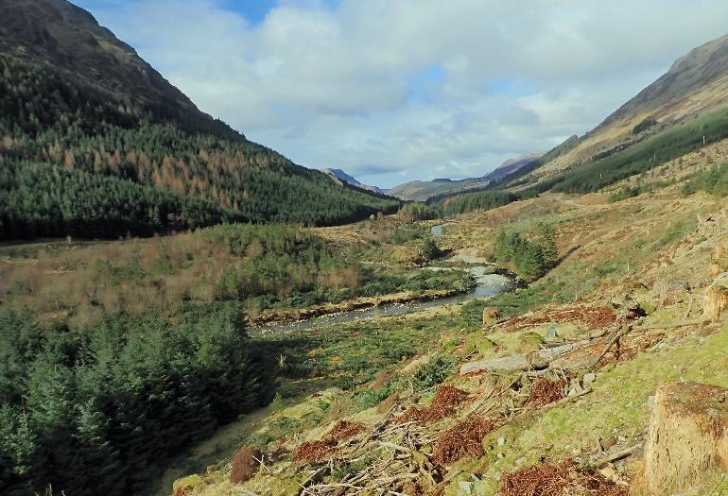
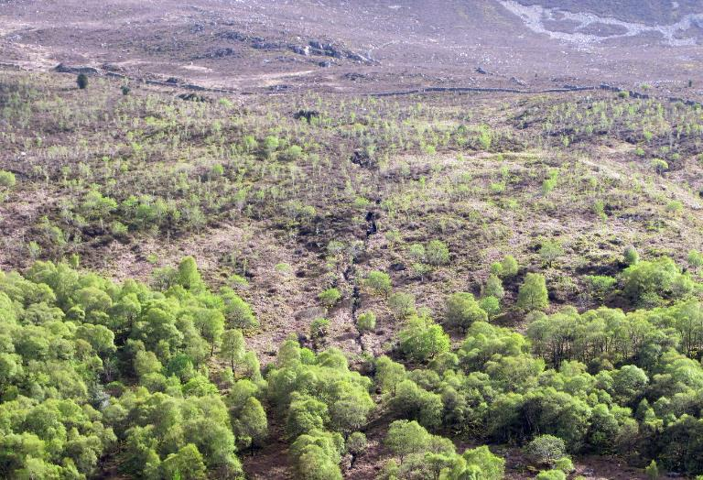
Land management today
Notes:
Today, clearfelling is being replaced by an approach focussed on regular thinning, opening of gaps and natural regeneration known as continuous cover forestry. This lets more light reach the forest floor which enables a wider range of plants to grow and increases biodiversity. Forest management at Ennerdale aims to develop a more diverse habitat including open glades, tall trees, open woodland and deadwood.
Switching from sheep to cattle grazing encourages natural regeneration, where trees and plants disperse their own seeds, which take root and grow.
Trees are still planted by hand, but a greater variety of native trees are planted as Wild Ennerdale looks to reduce the dominance of non native Sitka spruce.

Slide 9
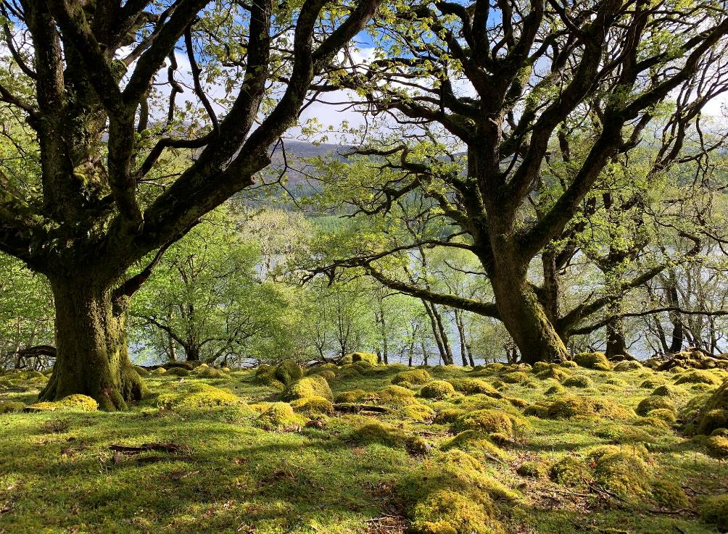
Managing
Side Wood,
a native
woodland
Notes:
Side Wood is an isolated area, located on the north face of the valley directly above the lake.
It is one of the best examples of a native oak and birch woodland that has existed since at least AD1600. These woodlands are called Temperate Rainforests as they are full of green mosses, liverworts and lichens.
Due to its ecological importance, the site has been designated a Site of Special Scientific Interest (SSSI), as it contains a rich biodiversity of rare plant species.
Forestry England and National Trust mange Side Wood together. Sheep have been excluded and some areas open to extensive very low density cattle grazing. Natural regeneration is expanding the woodland uphill which is not seen anywhere else in the Lake District.

Slide 10
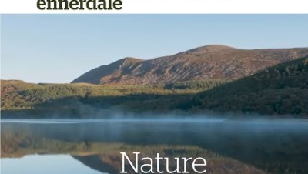
Benefits for nature
Notes:
This video is 5mins long, so you may just want to watch up to 2:45.
Cattle graze the land, breaking up the dense ground litter and promoting seed germination. In the middle valley where the cattle have been free to roam for 10 years, and the forest thinned instead of clearfelled, bird numbers have gone up by 63% and species diversity has increase by 23%.
In 2022, Wild Ennerdale was declared a new National Nature Reserve (NNR). Ennerdale is home to an abundant and wide variety of plants, birds and butterflies. As a NNR, the management of Wild Ennerdale will focus on nature restoration and creating a healthy dynamic ecosystem for both wildlife and people.

Slide 11
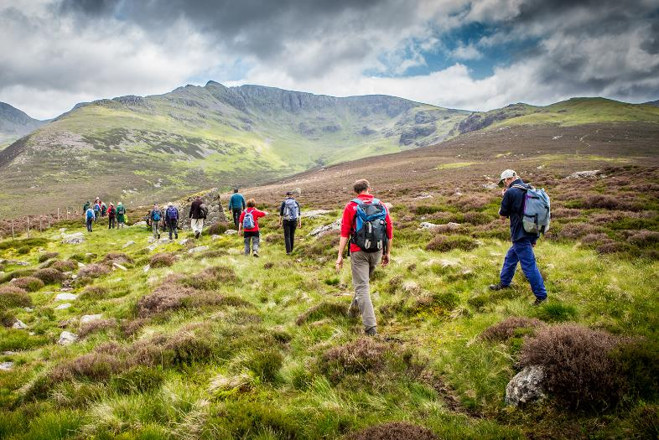
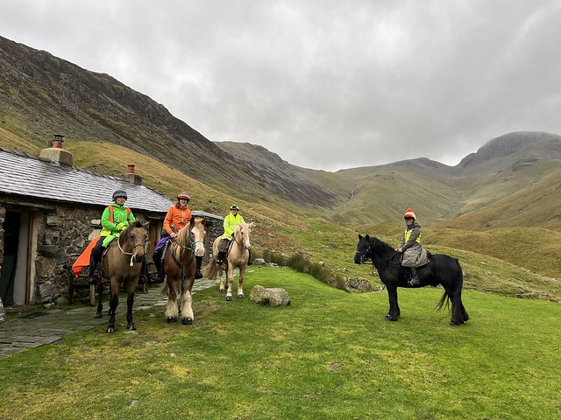
Benefits for people
Notes:
Ennerdale provides opportunities for a wide range of activities to enable people to get closer to nature and enjoy outdoor fun and adventure.
There are 50km of trails and paths for walkers, including routes to local mountain peaks, and 16km of forest roads for cyclists. Ennerdale Water provides opportunities for canoeing and bird watching. A network of forest roads and bridleways enable horse riders to explore the area.

Slide 12
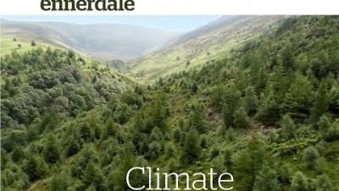
Managing Wild Ennerdale today
Notes:
Wild Ennerdale has a future natural approach to managing the valley. Led by natural processes but accepting and working with both native and non native species.
Allowing the river to take its natural course reduces the flood risk further downstream. Planting trees not only helps by locking up carbon but also reduce the flood risk.

