Slide 1
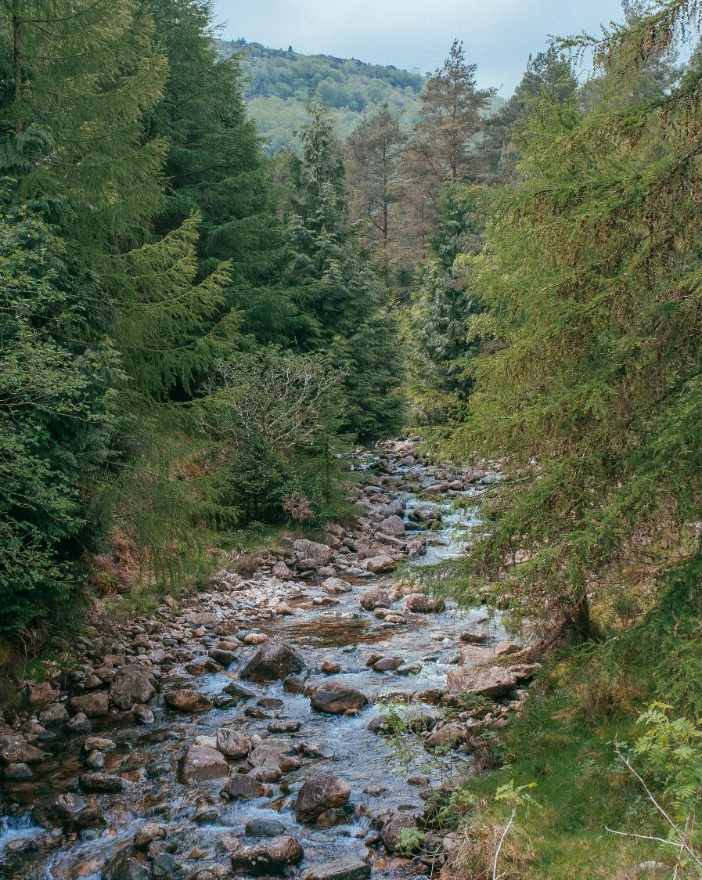
Wild Ennerdale

Slide 2
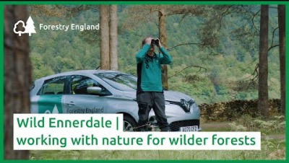
Wild Ennerdale

Slide 3
Map activity
What is the name of the river that flows through Ennerdale Valley to join Ennerdale Water?
Why might schools visit Low Gillerthwaite, at the eastern end of Ennerdale Water?
Give the six-figure grid reference for the youth hostel at High Gillerthwaite.
Give the name of the viewpoint in grid square 1115. What is its height?
What type of woodland covers most of Ennerdale valley?
What type of woodland is found alongside the SW shore of Ennerdale Water?
(a) Calculate the width of the coniferous woodland from Gillerthwaite in the south to the straight edge of the woodland to the north.
(b) Calculate the widest extent of continuous
coniferous forest across the valley.
8) (a) Apart from trees, what other forms of
vegetation are found in the valley?
(b) How does this variety of vegetation promote biodiversity?
9) At what altitude is the upper edge of the forest.
Is it roughly 300m, 350m or 400m above sea
level?
10) Using map evidence together with online
research, describe the attractions and facilities
for people who wish to visit Ennerdale Forest.

