Slide 1

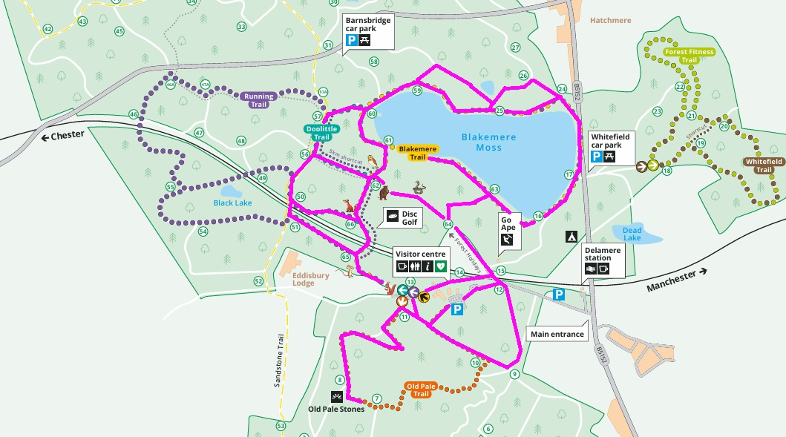
*The trails marked in pink are approved for use with our all-terrain mobility scooters

Slide 2

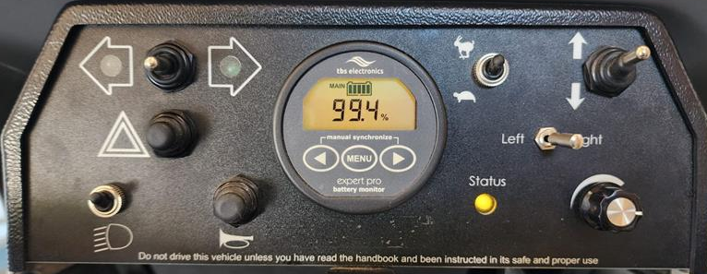
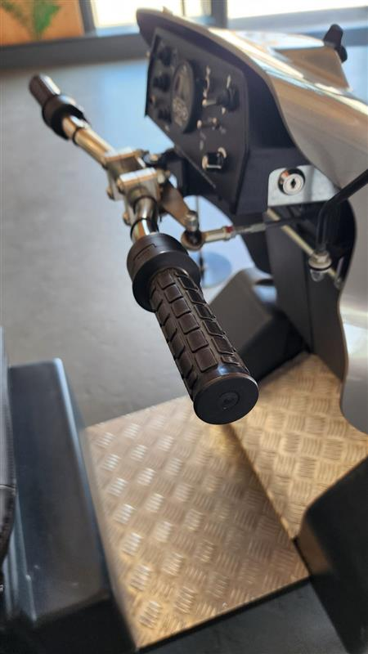
Battery
Fast & Slow
Forward & Reserve
Indicators
Duty Ranger phone number:
07703 211869
Battery Life:
We aim to ensure the all-terrain mobility scooter battery is above 90% before each hire, providing a minimum range of 20 km (12 miles). If the battery level drops to 20% or below, please return to the Visitor Welcome.
If the all-terrain mobility scooter remains stationary for 10 minutes, it will automatically switch off. Simply restart it to continue your journey.
Security:
Do not leave valuables unattended. Please take belongings with you, or lock them inside the all-terrain mobility scooter and take the key with you.
Pets:
Pets are not permitted on the all-terrain mobility scooters, or to be led by the person operating it. If you are accompanied by a dog, your walking companion must always remain in control of the animal.
Hazard
Status Light
Horn
Head Lights
Speed dial
Twist grips:
Turn toward you to go and let go to stop

Slide 3
